Slide 1


Slide 2
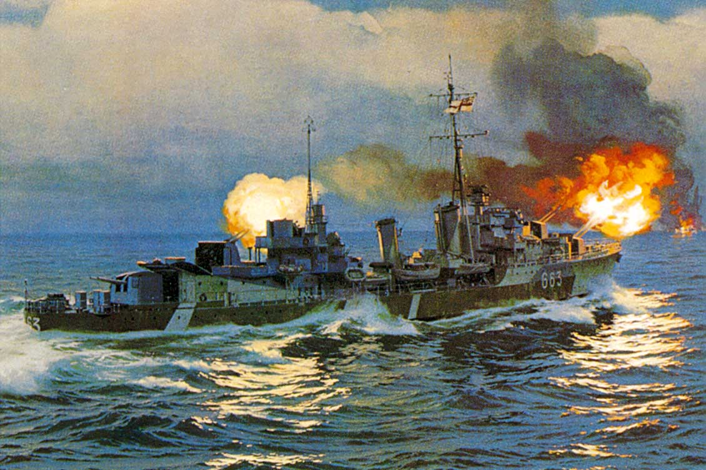
WWII era - 1943 to 1945.

Slide 3
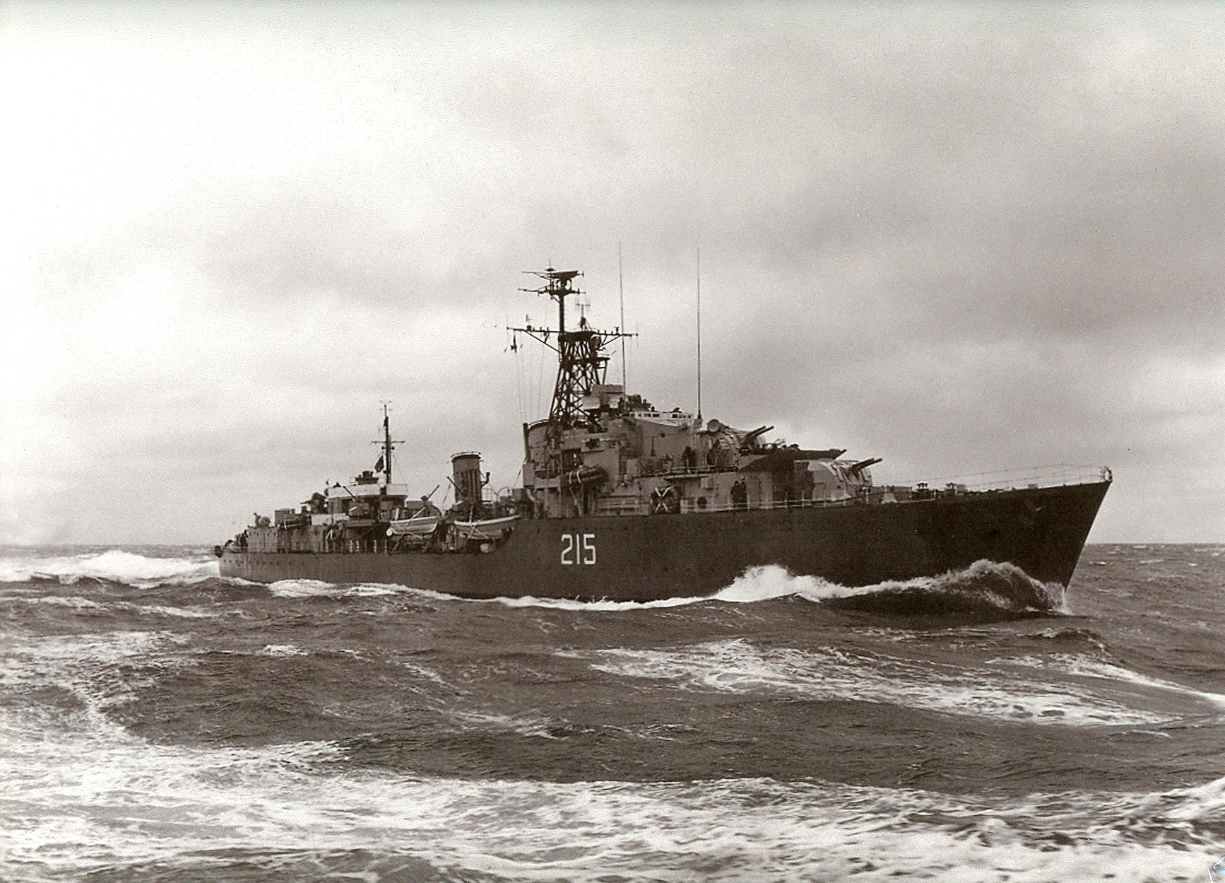
Korean War Era - 1952 to 1954.

Slide 4
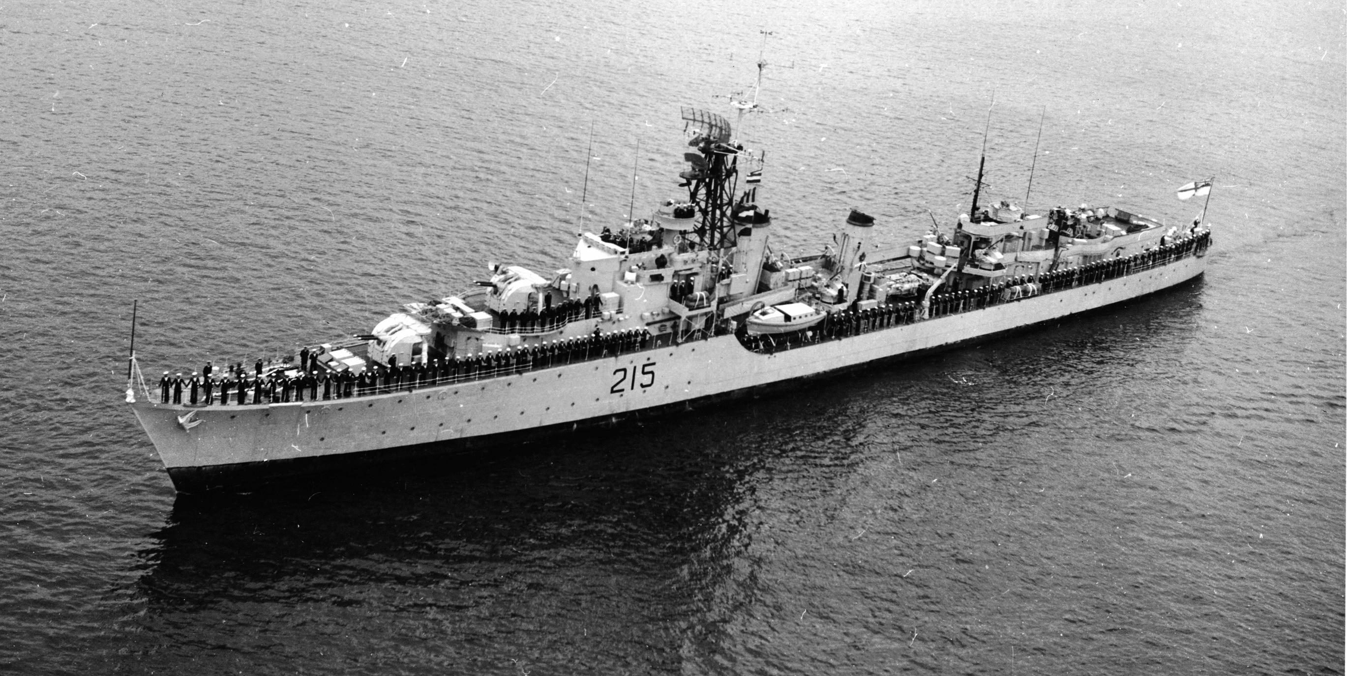
Peacetime Era - 1954 to 1963.

Slide 5
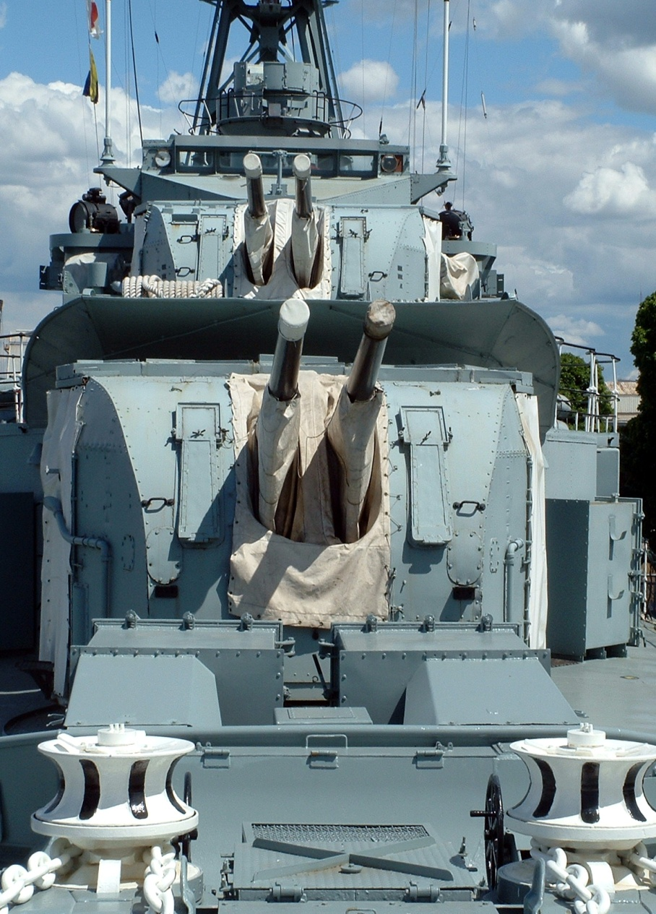
4 inch High /Low angle guns. +85 to -10 degrees elevation. Lower one is ‘A’ gun. Upper one is ‘B’ gun. ‘A ‘gun used for surface targets. ‘B’ gun for aircraft.

Slide 6
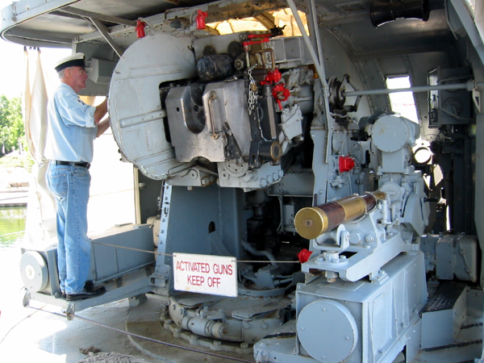
Rear view of 4 in gun. The fuze setter is at the lower right with a practice shell in the cradle.

Slide 7
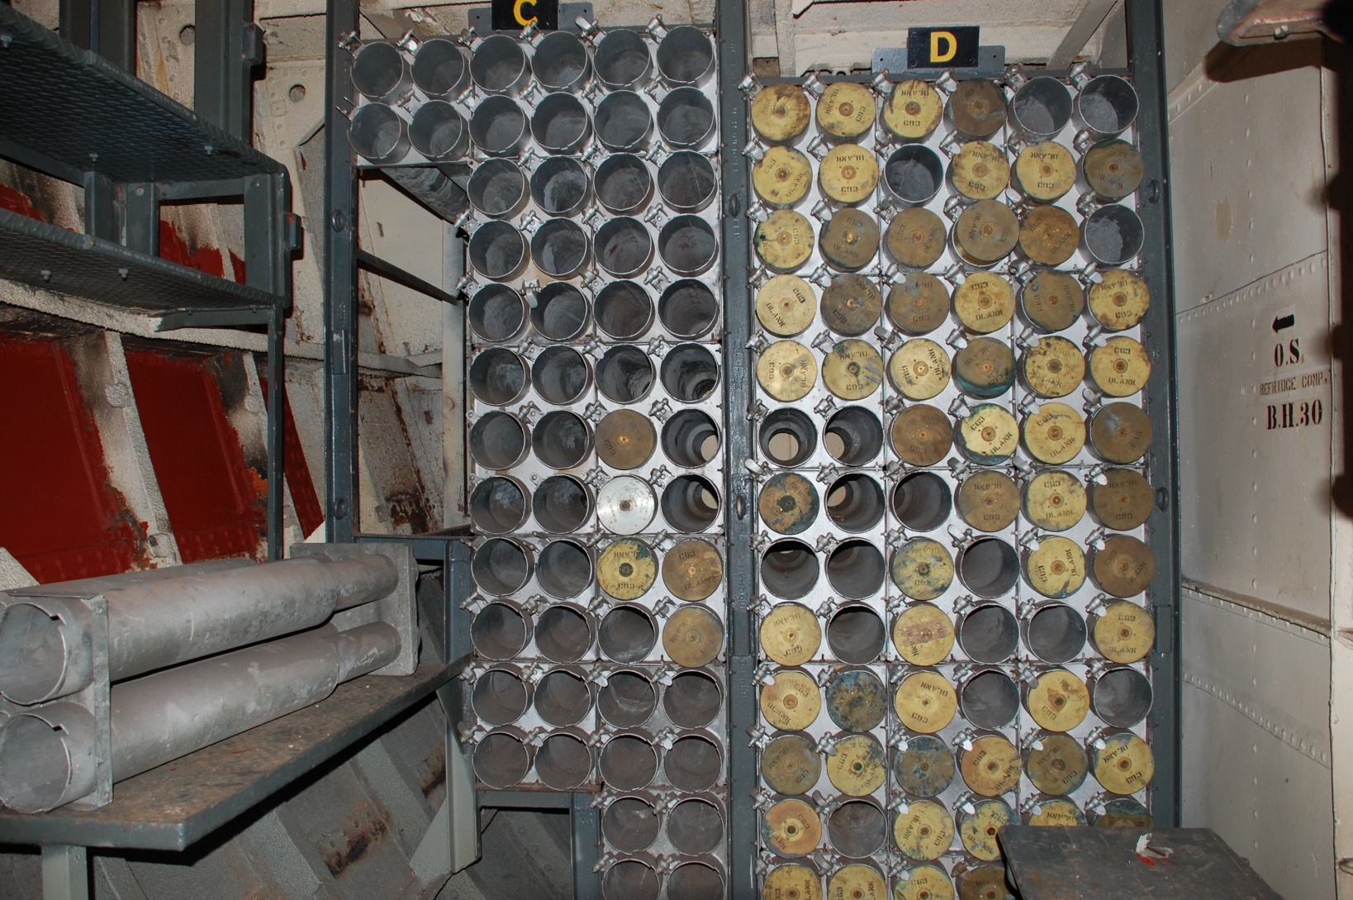
One of two 4 inch magazines – Total capacity was 1121 rounds. The range of the 4 inch gun was around 8 nm.

Slide 8
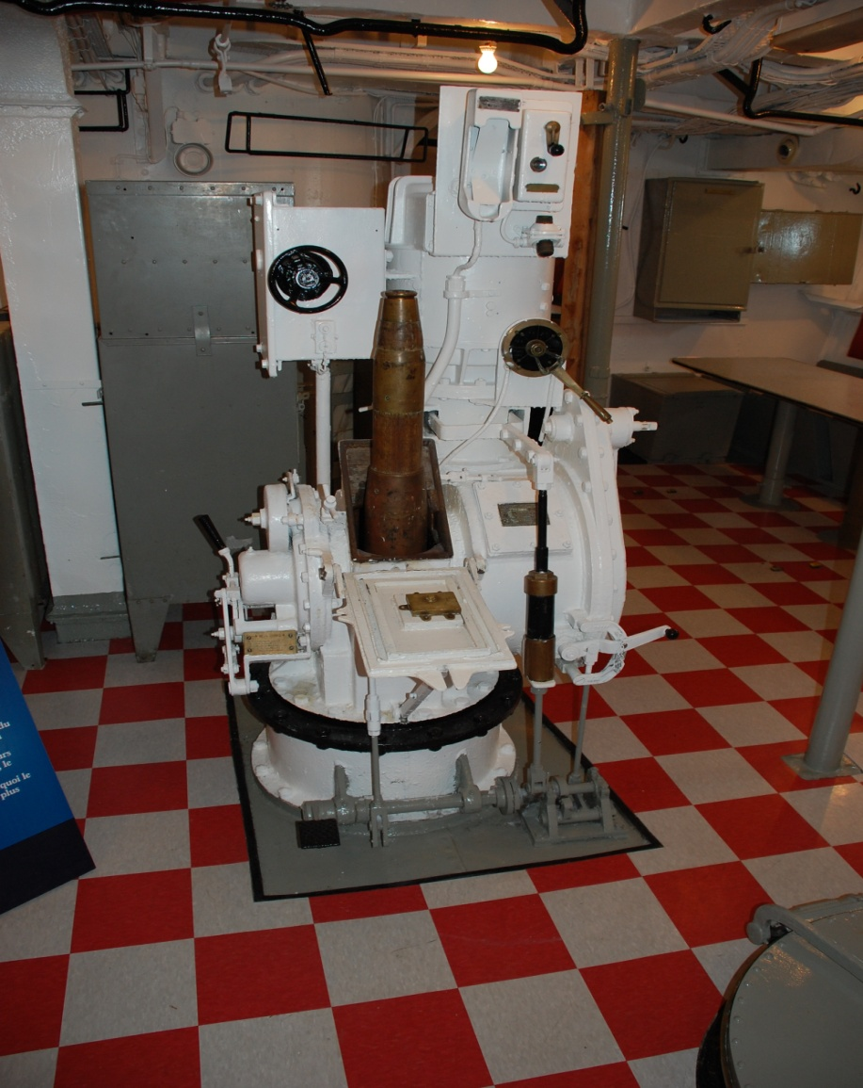
One of several ammo hoists for the 4 inch shells. Each shell weighed 66 pounds.

Slide 9
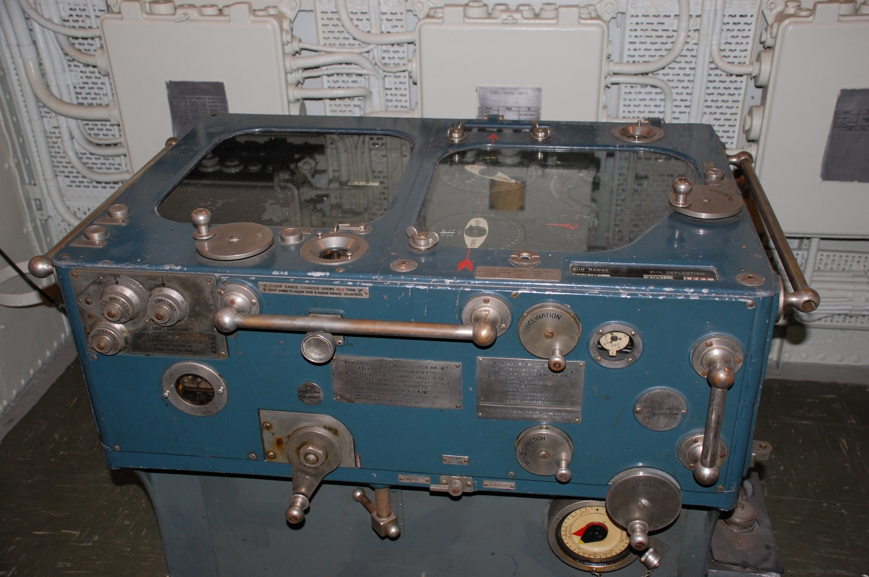
The Admiralty Fire Control Clock. (AFCC) is a mechanical computer which produced the ‘Fire Control Solution’ (ie bearing and elevation) for ‘A’ Gun.

Slide 10
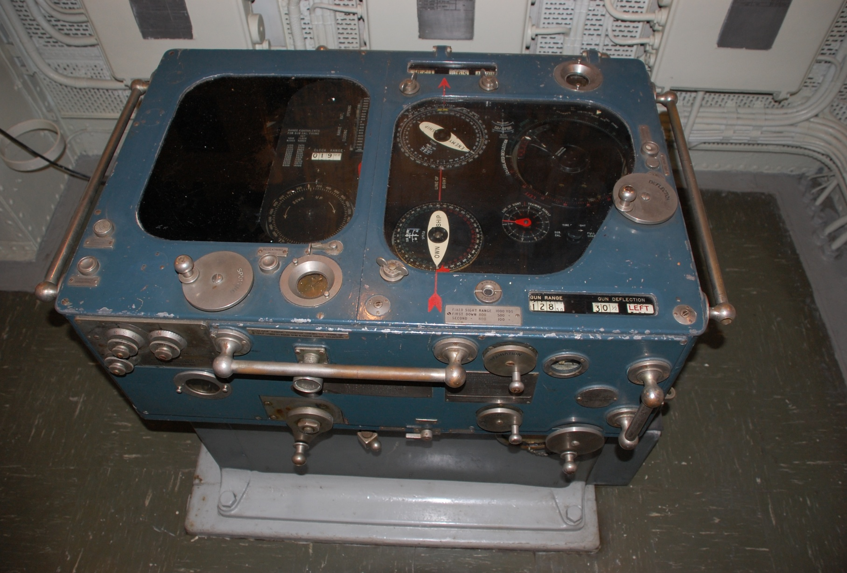
AFCC top view. It was located in the Transmitting station. Range information provided by a rangefinder.

Slide 11
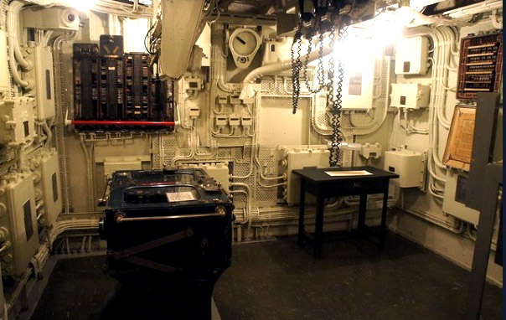
Overall view of the Transmitting Station. When the WWII era 285 Fire Control System was removed, it created a lot of empty space in this compartment.

Slide 12
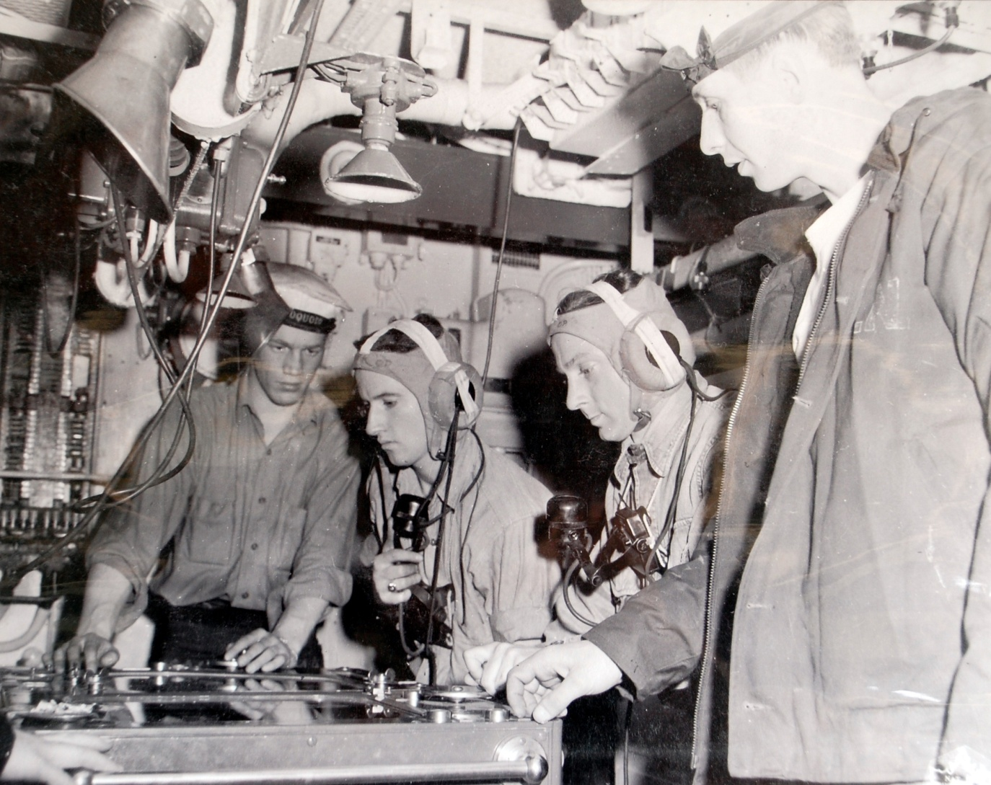
Gun crew manning the AFCC

Slide 13
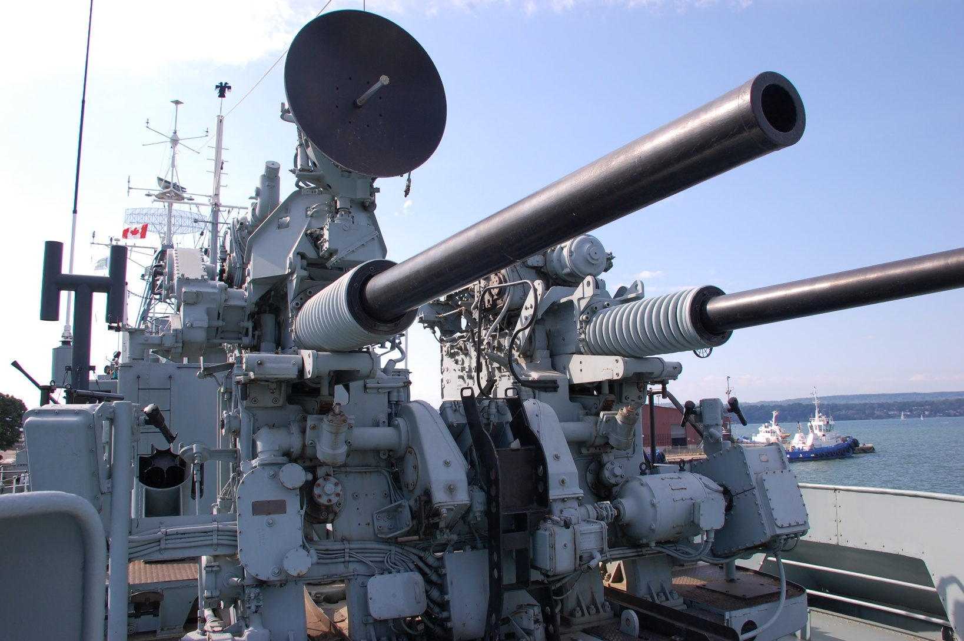
3 inch 50 gun - Up 80 rounds per minute with both barrels firing. Required a gun crew of 15.

Slide 14
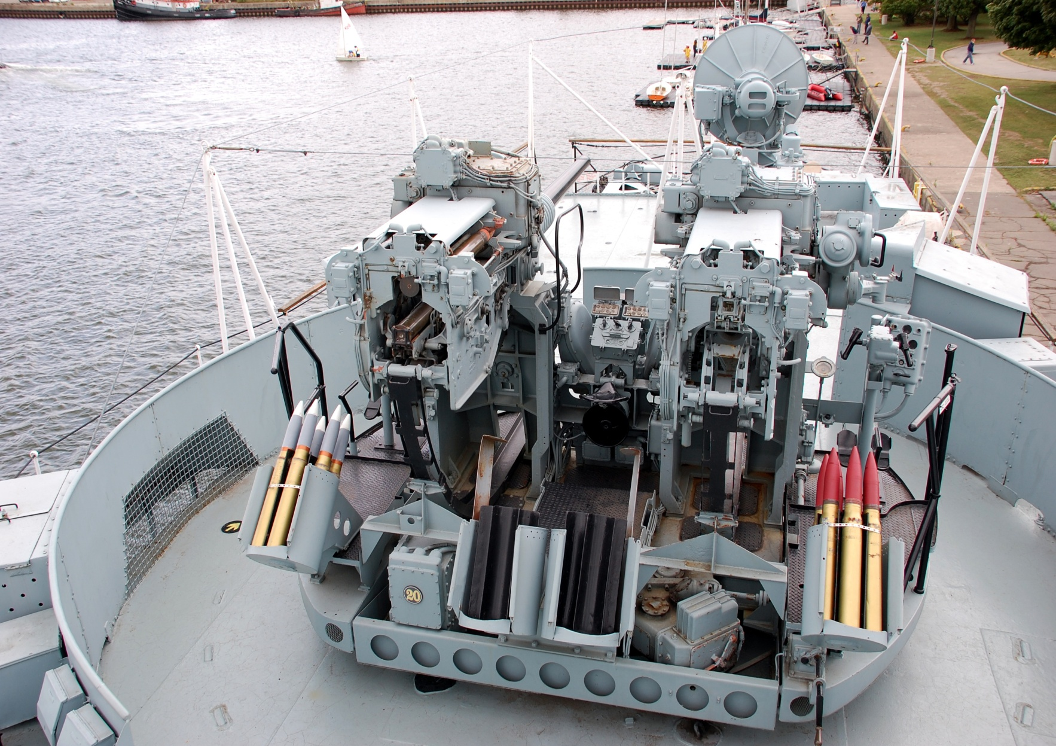
3 inch 50 gun - rear view. In Korea, these guns shot at trains supplying war material from China.

Slide 15
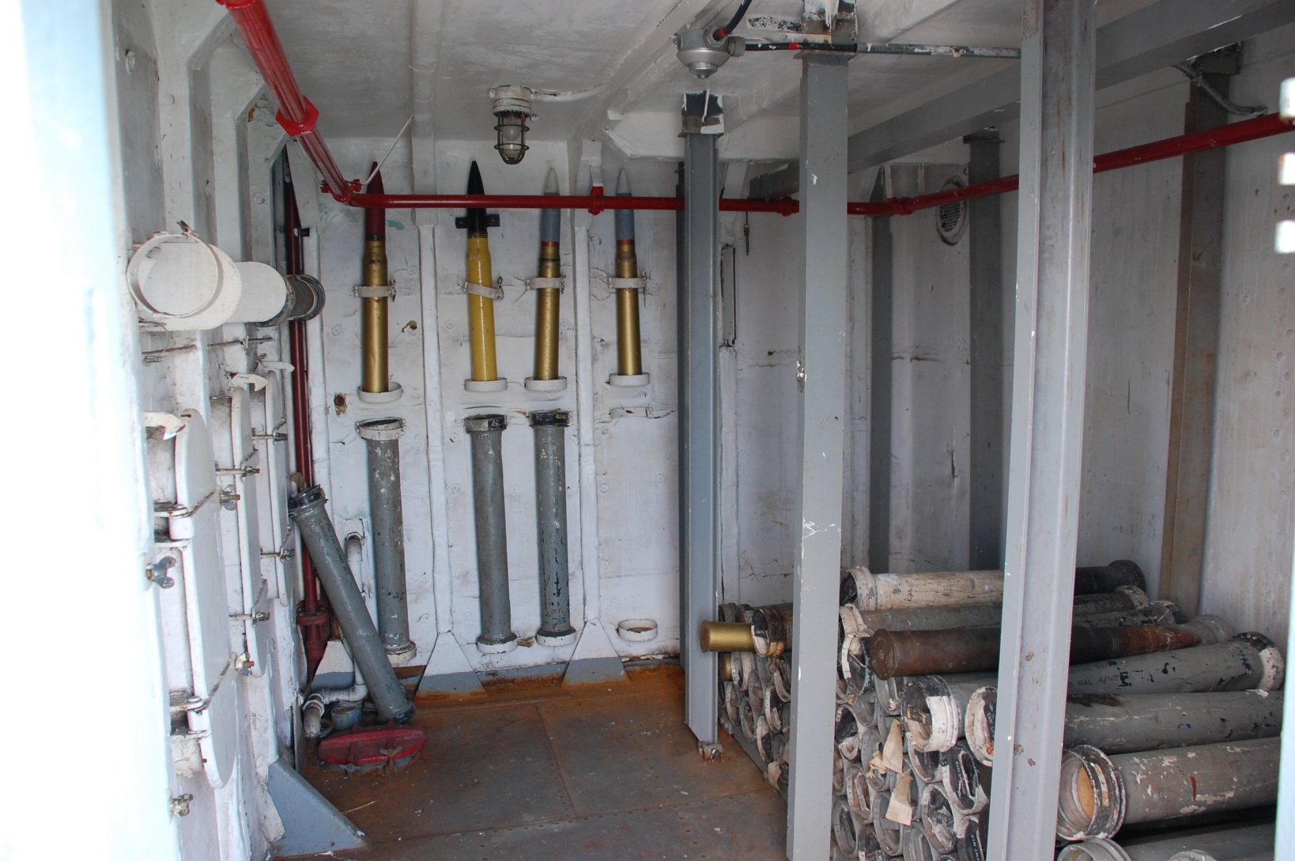
Ready Use compartment for 3inch 50 shells.

Slide 16
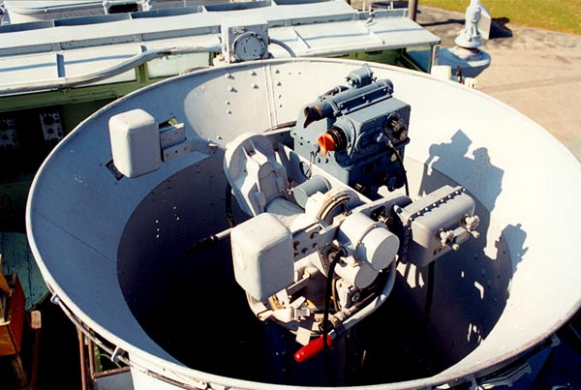
Mk 29 gunsight. One fitted for the 3in 50 gun; one for ‘B’ gun. The aimer tracked the target by optical means. The motion of the gunsight imparted by the aimer controlled the aiming of the gun barrels.

Slide 17
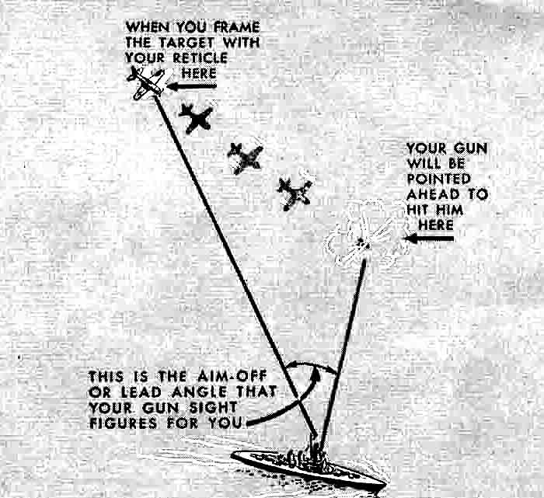
Leadoff angle explained.

Slide 18
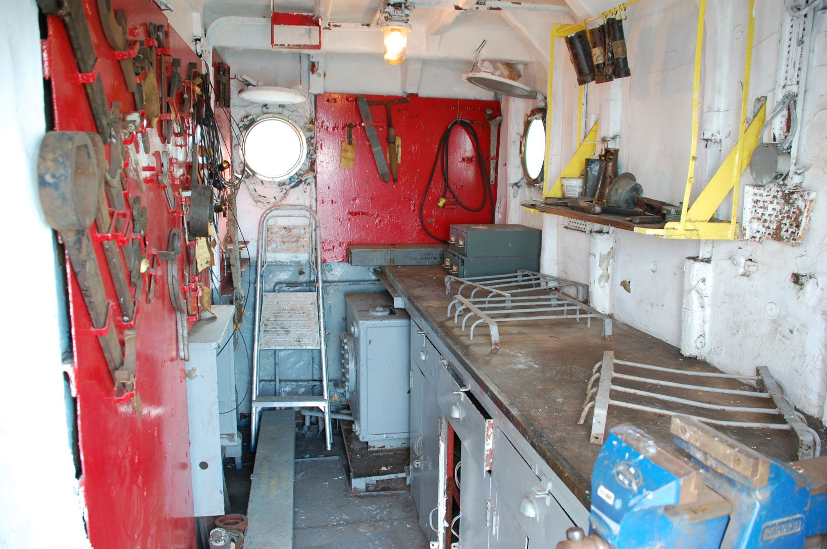
Ordinance Workshop. Minor problems with the weapons would be fixed here.

Slide 19
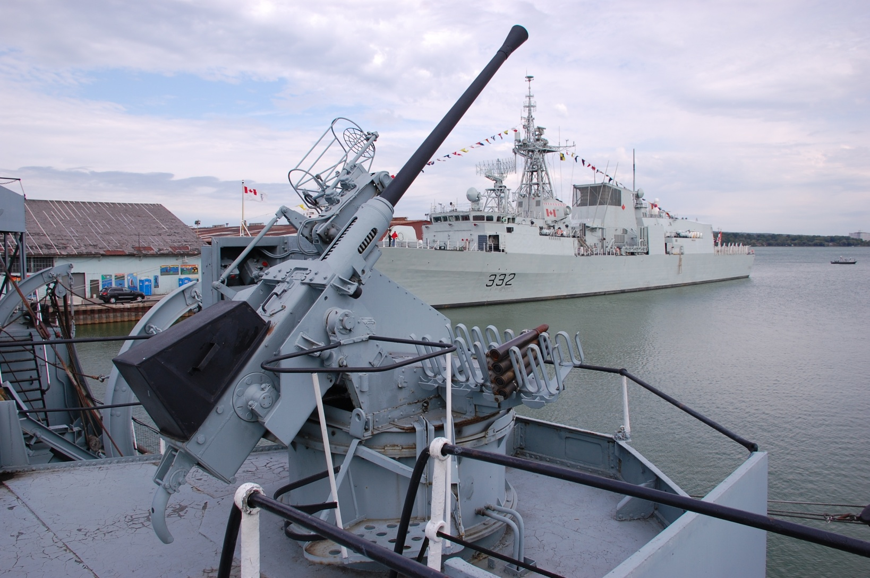
40mm A/A gun called a Boffin . It was a 40 mm Bofors gun mounted on a Oerlikon power mount. 120 rounds per minute.

Slide 20
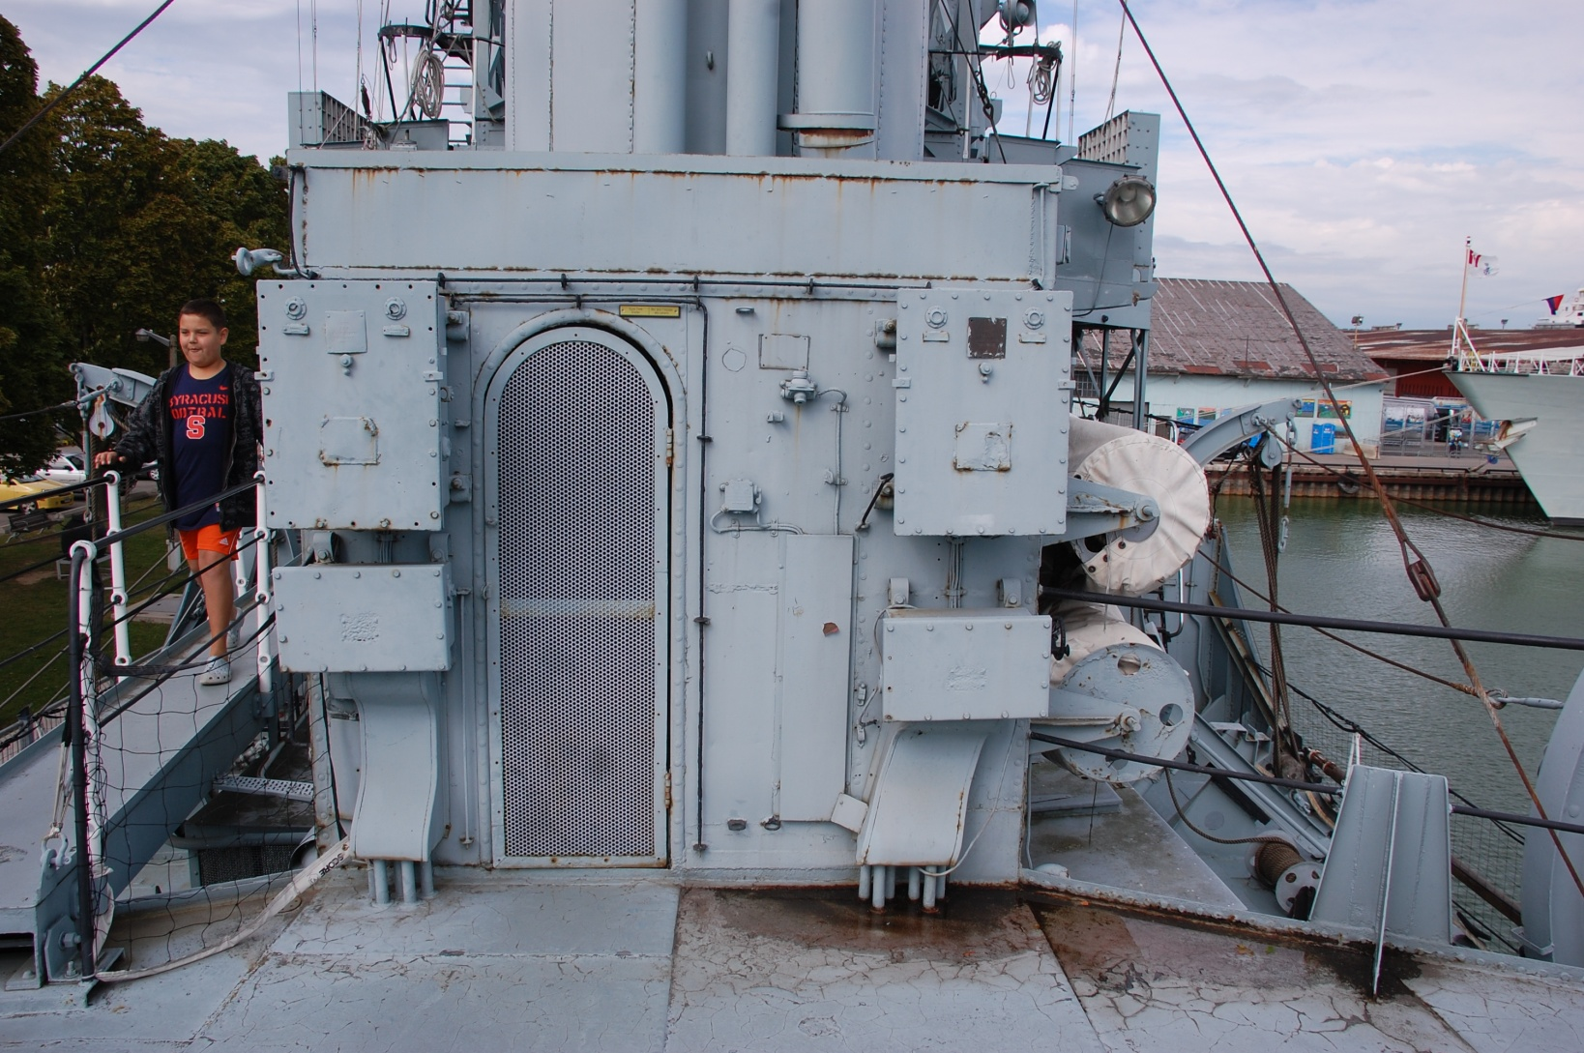
40 mm gun crew shelter.

Slide 21
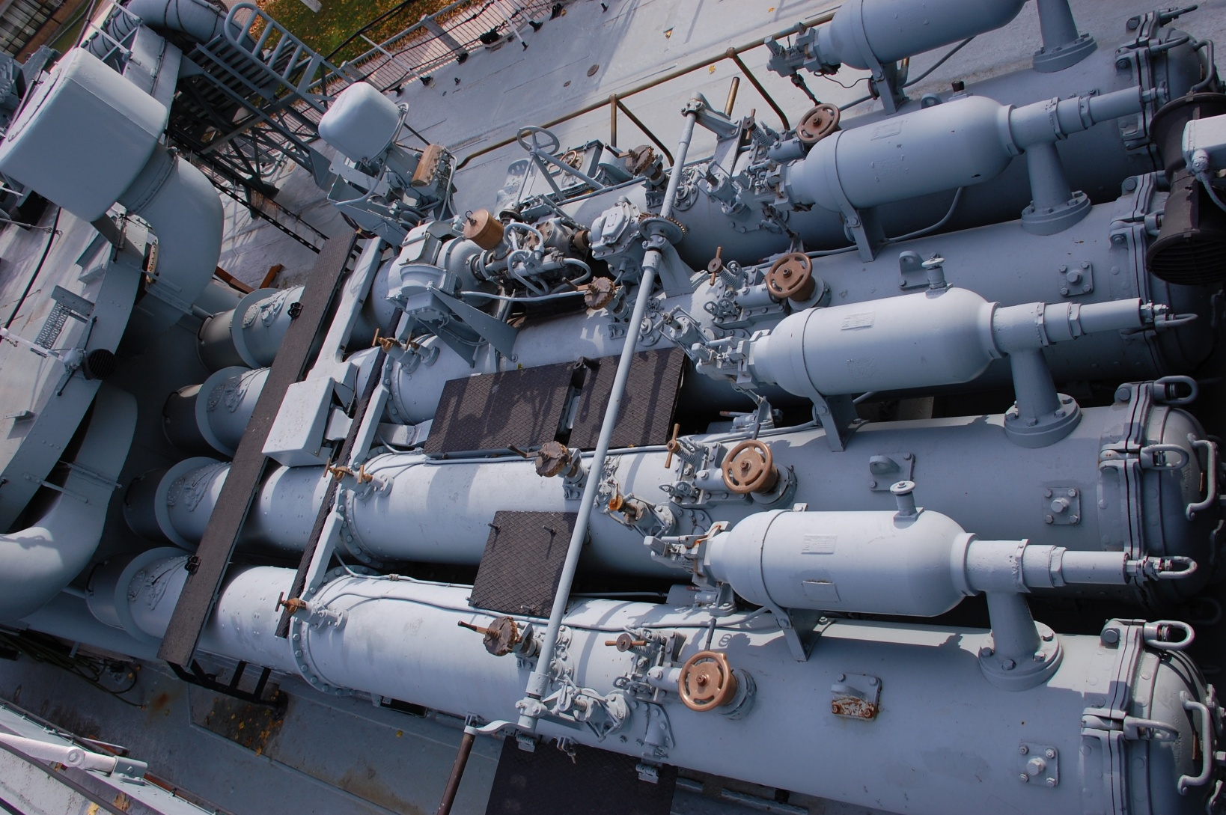
Torpedo Launcher. The ship could only fire 4 torpedoes. Only used to “finish off” a badly damaged opponent or destroy enemy docking facilities.

Slide 22
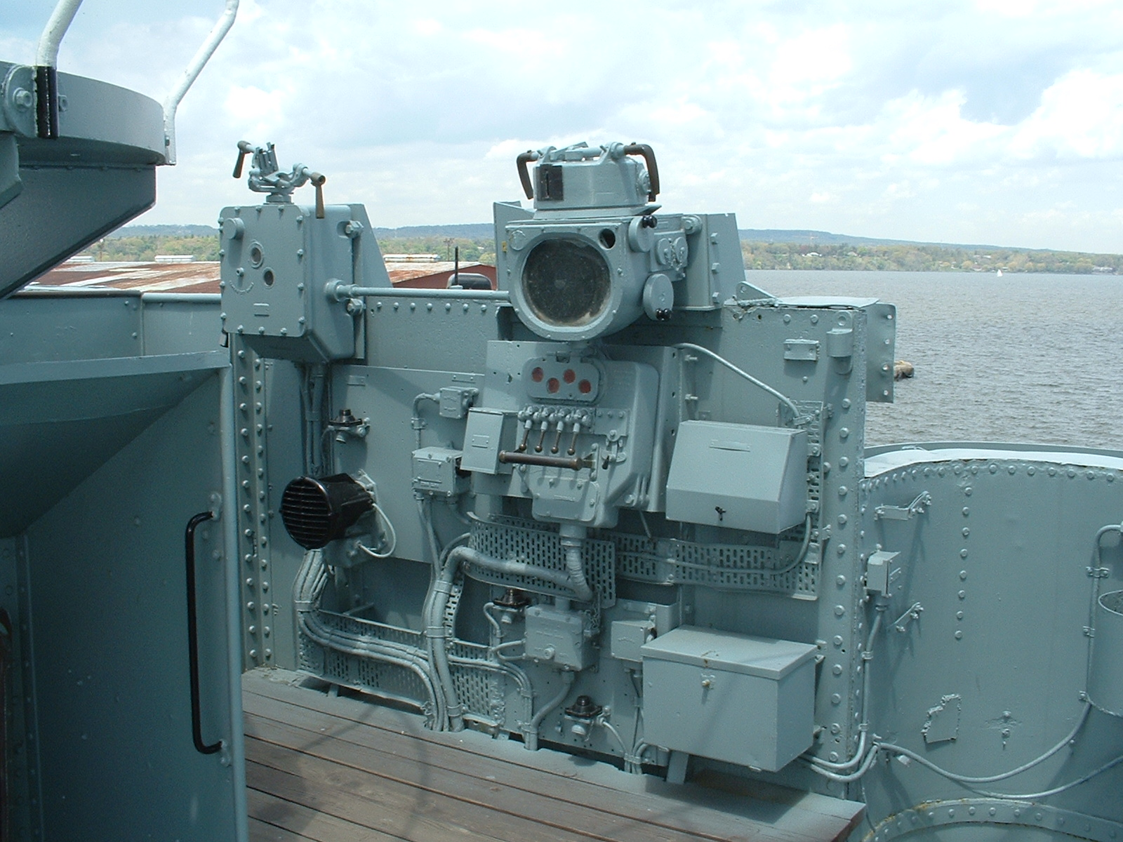
Remote Torpedo Firing station – one on port, one on starboard side of bridge.

Slide 23
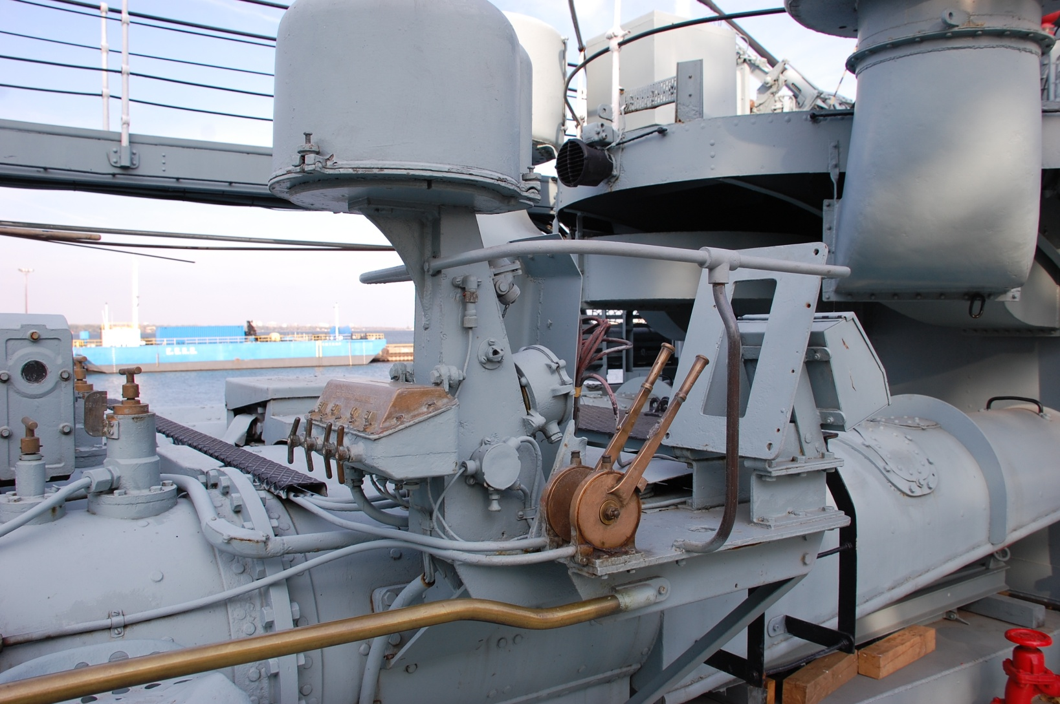
Local torpedo firing position. Used manually if bridge was put out of action or if there was a system failure.

Slide 24
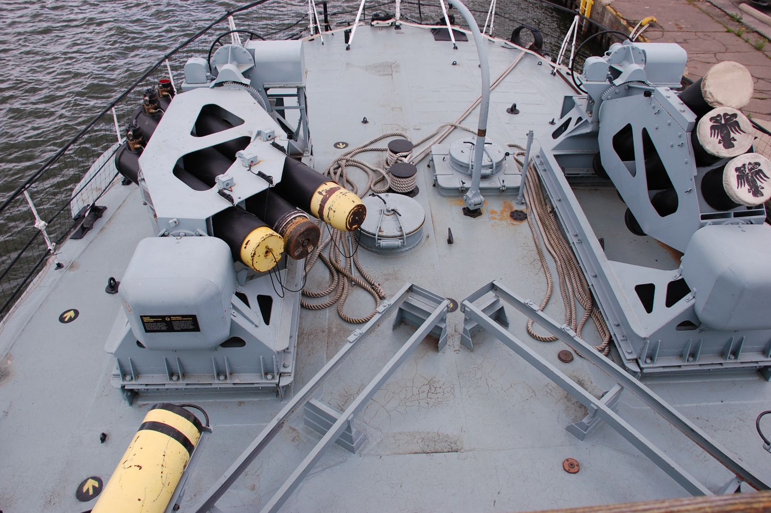
Squid mortars. This was the follow on anti-submarine weapon to WWII era depth charges and Hedgehog.

Slide 25
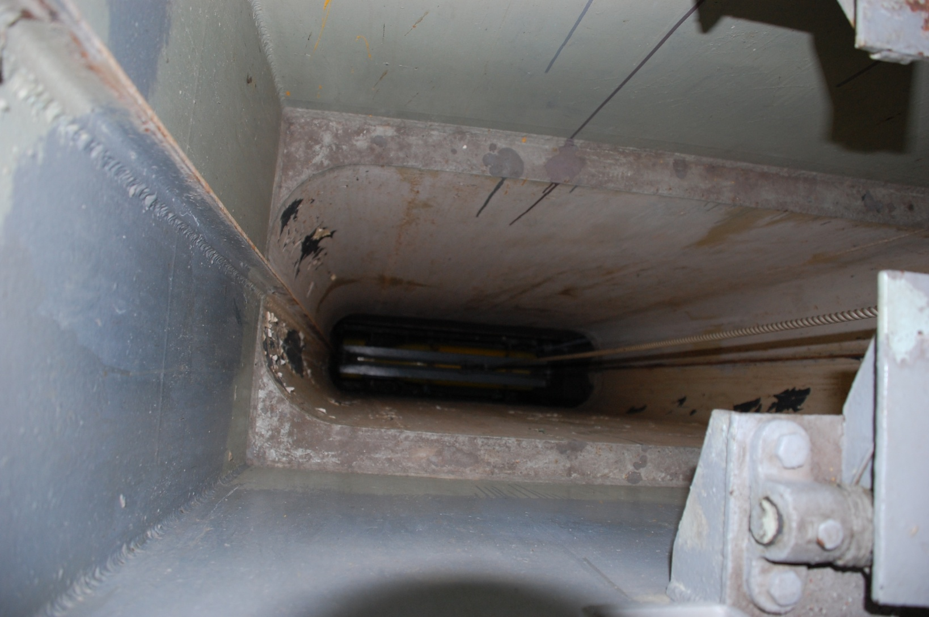
Squid hoist. (looking down the shaft.) It raised the Squid bombs from the magazine to the Squid Handling Room. The magazine could hold 46 Squids. Each weighed 300 pounds.

Slide 26
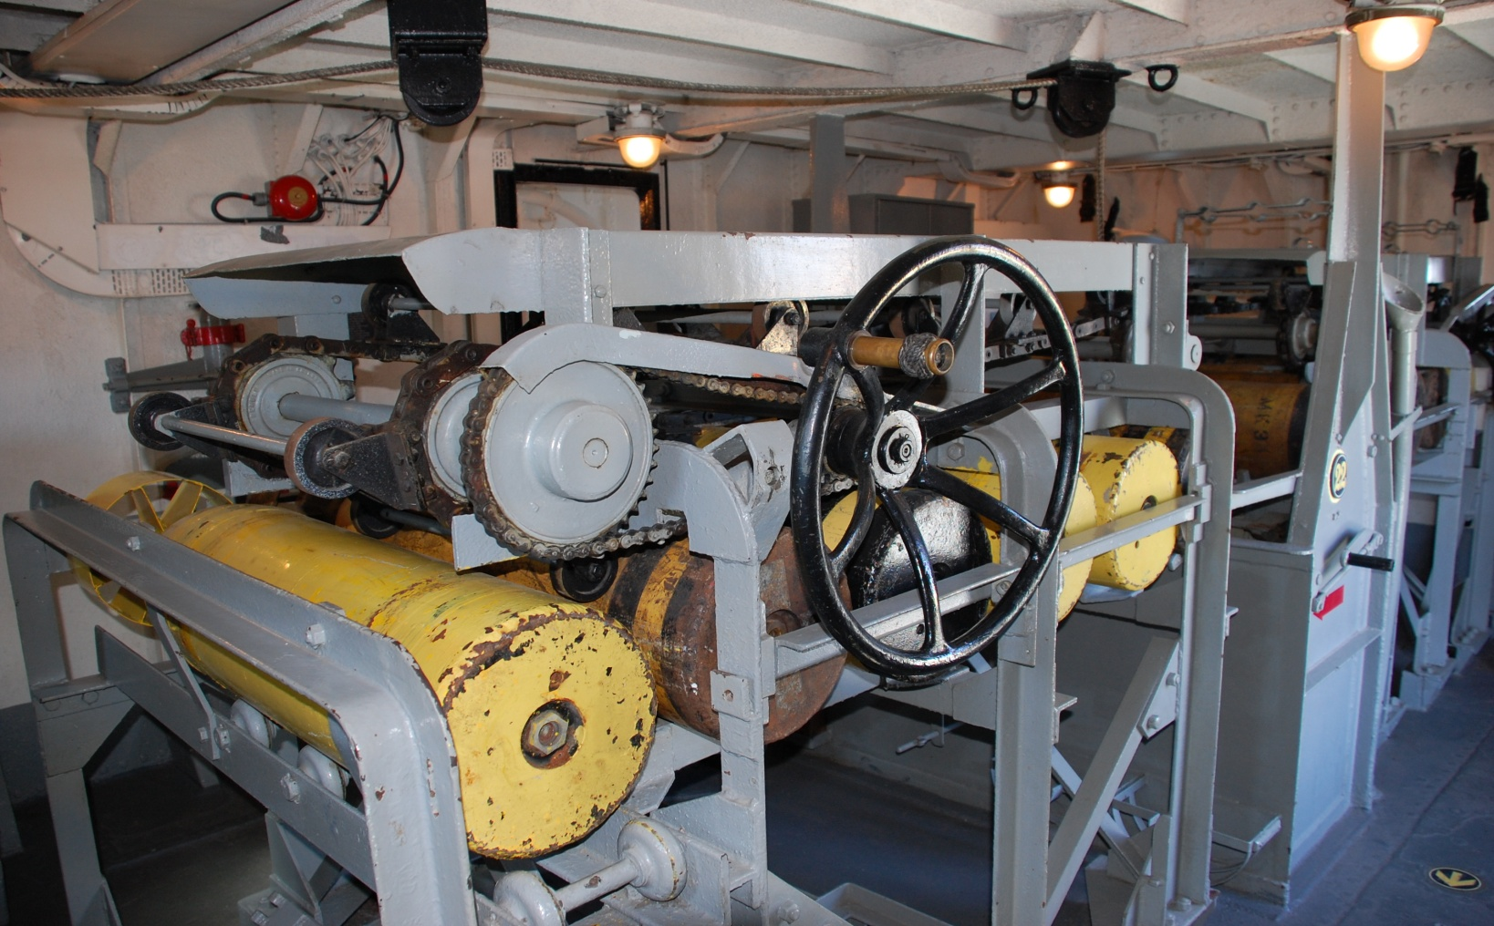
Squid Handling Room. The Squids were rolled off the hoist and unto left and right racks. From there, they were pushed out of the room to the outside.

Slide 27
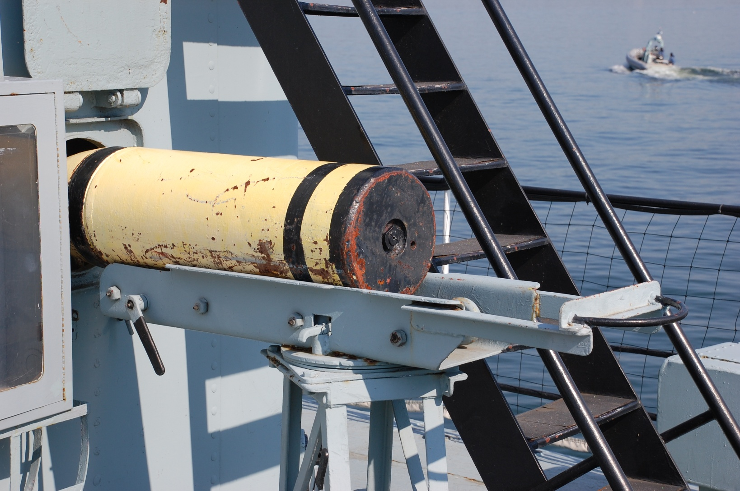
One Squid, on its way out to be loaded unto the Squid trolley. When launched, the bomb went over the foremast and landed about 200 yards in front of the ship and to either side.

Slide 28
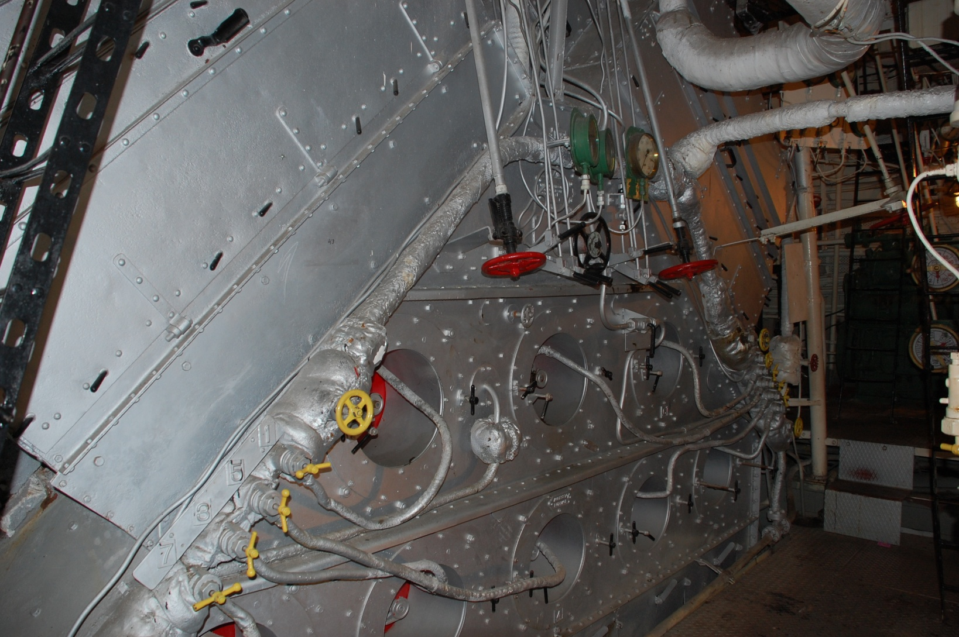
Boiler #3 . The boiler rooms were pressurized when underway. Boiler #3 exhausts to the smaller of the two funnels. Boilers #1 and 2 exhaust to the bigger funnel.

Slide 29
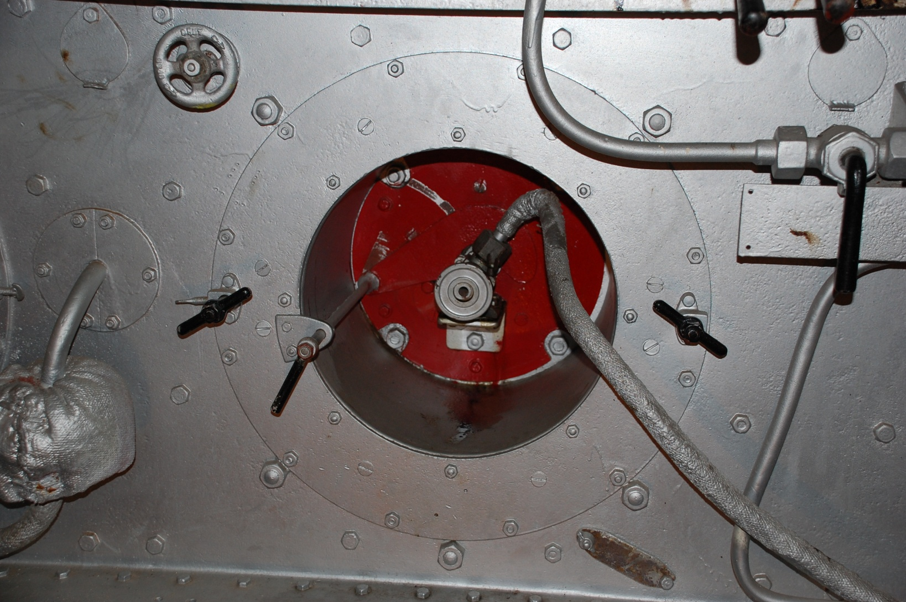
Nozzles could be shut down for cleaning while underway. HAIDA carried 500 tons of Bunker ‘C’ oil.

Slide 30
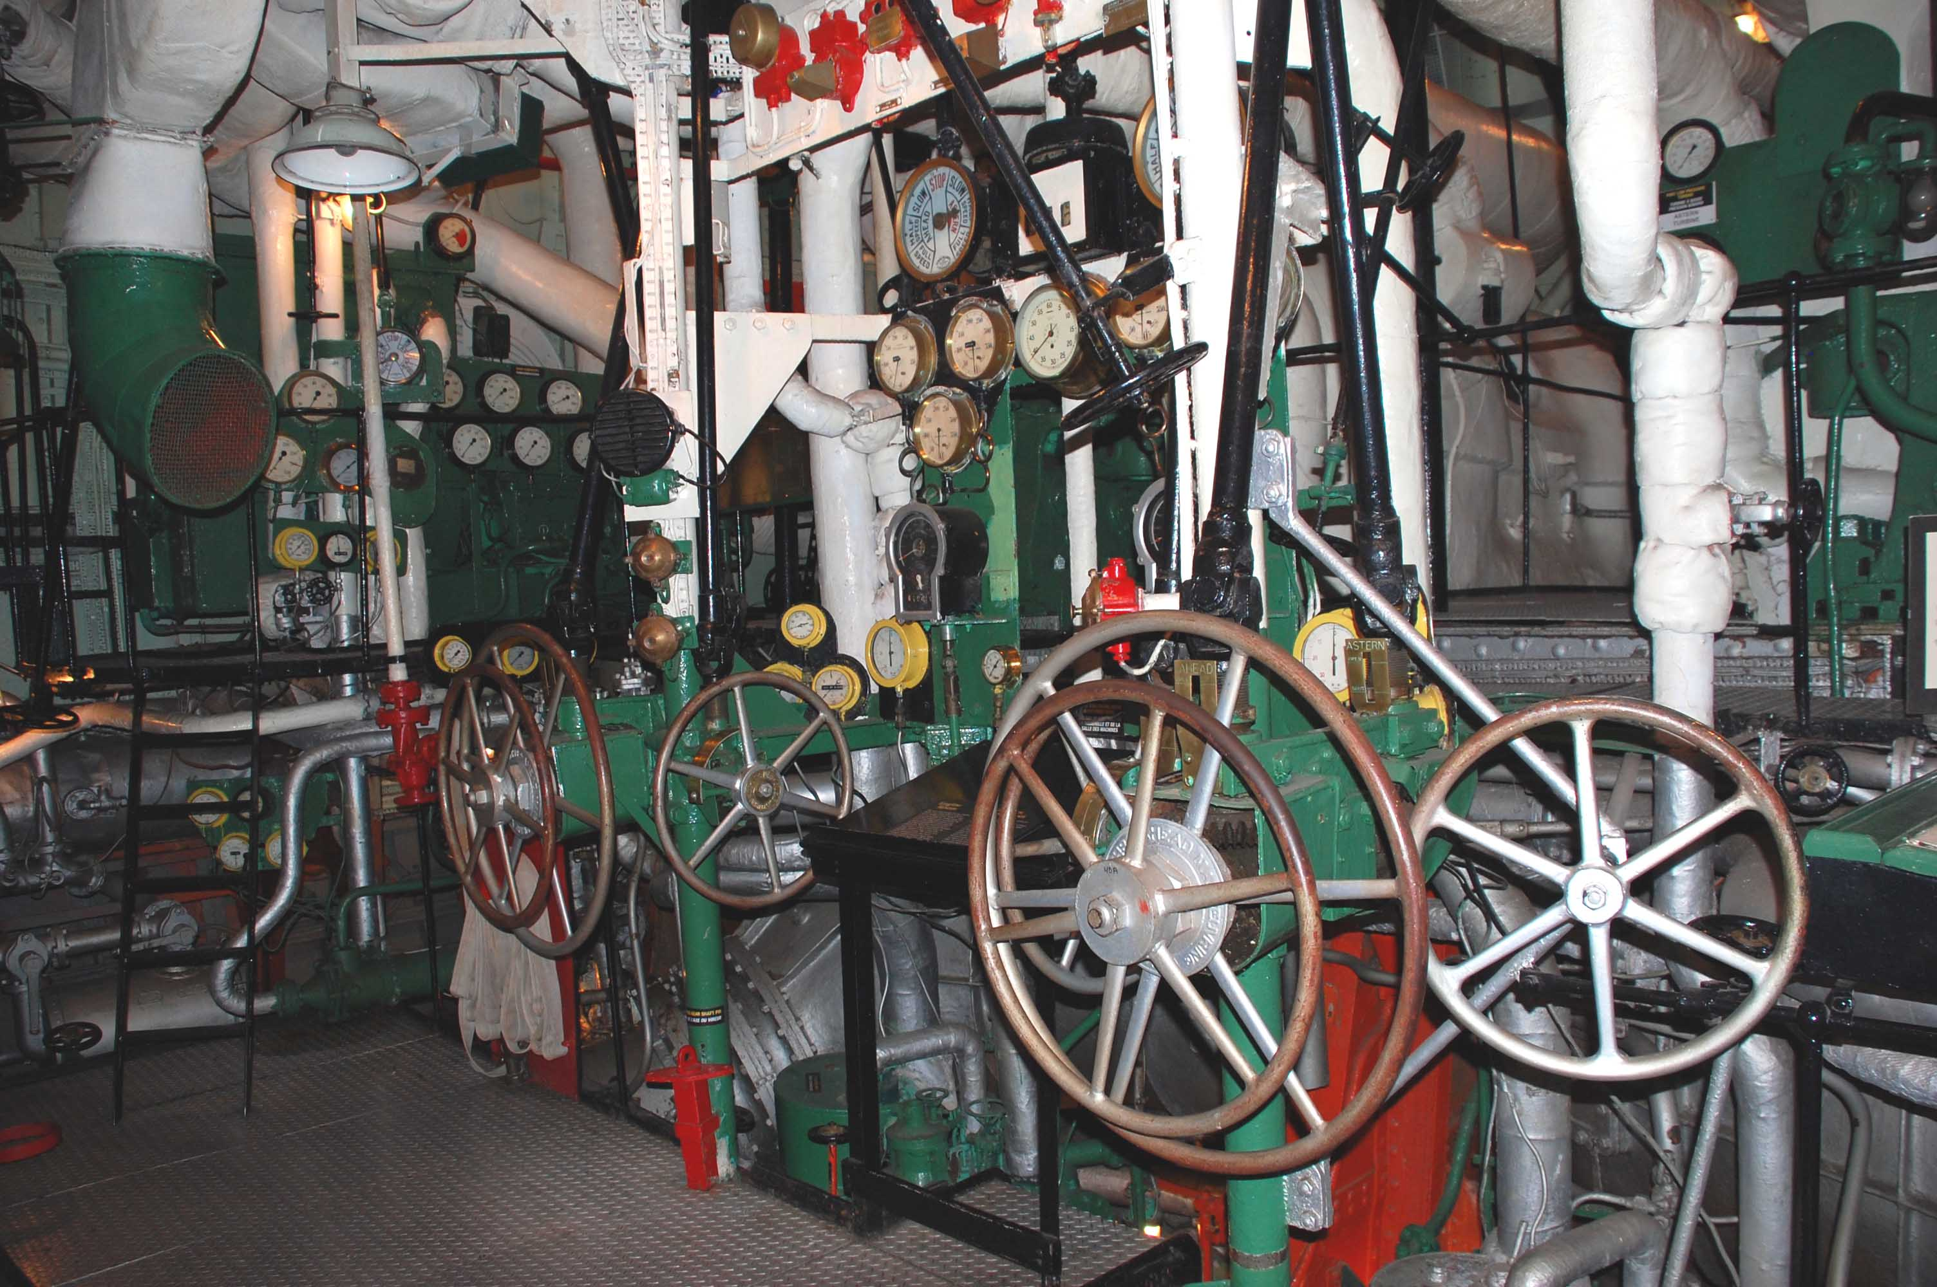
Engine controls and instrumentation.

Slide 31
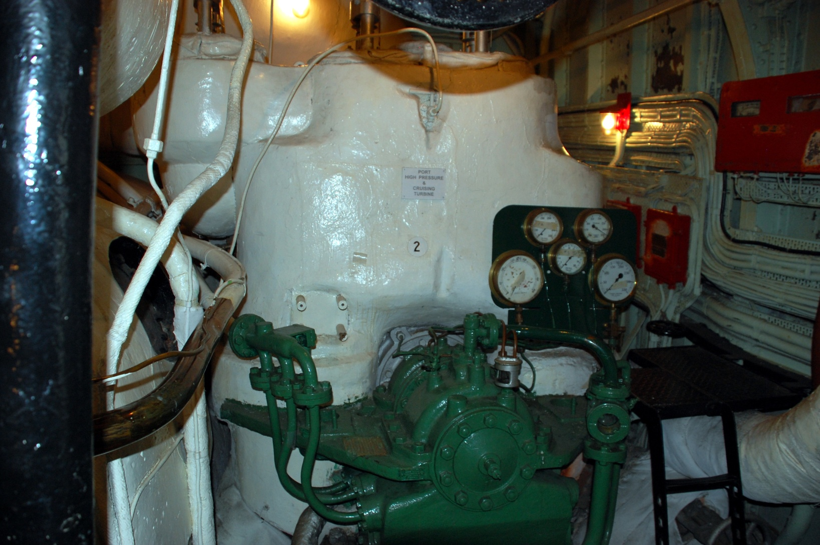
Front view of 22,000 shp Parsons turbine. (1 of 2)

Slide 32
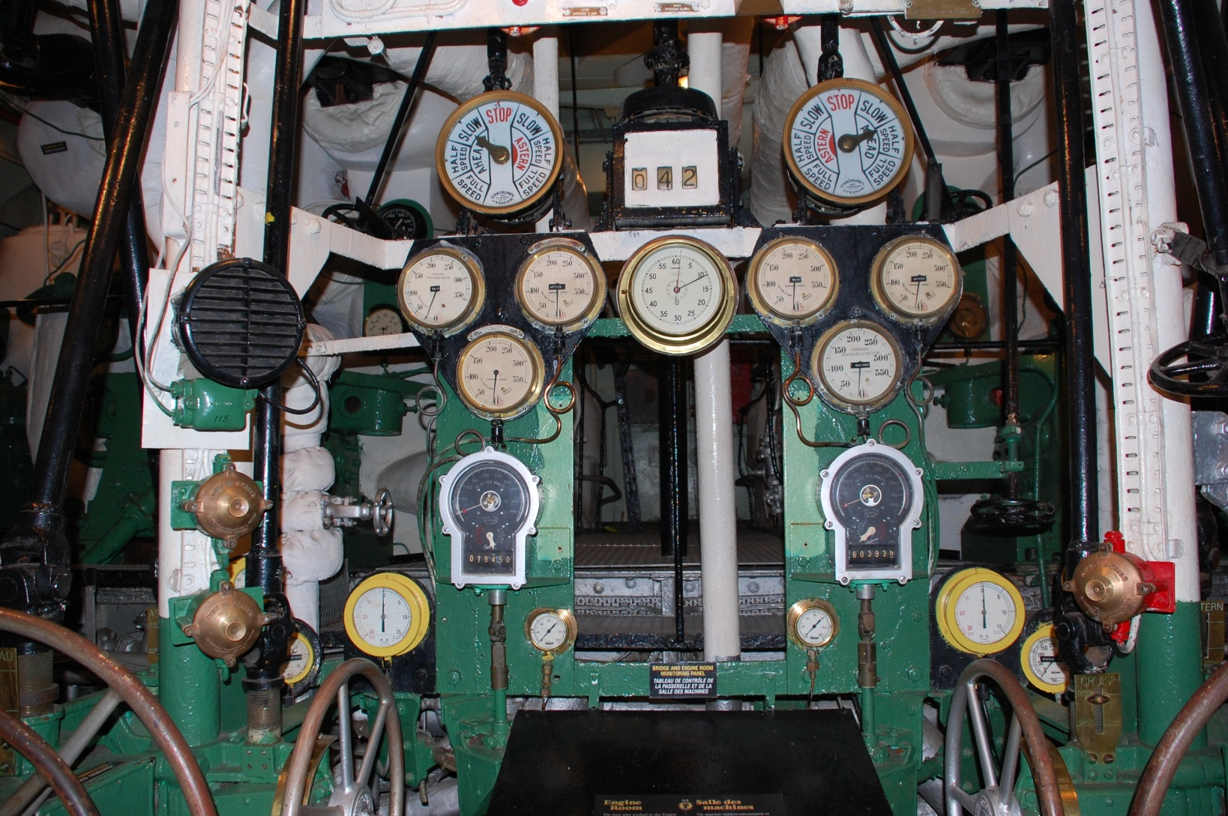
Engine instrument panel close-up

Slide 33
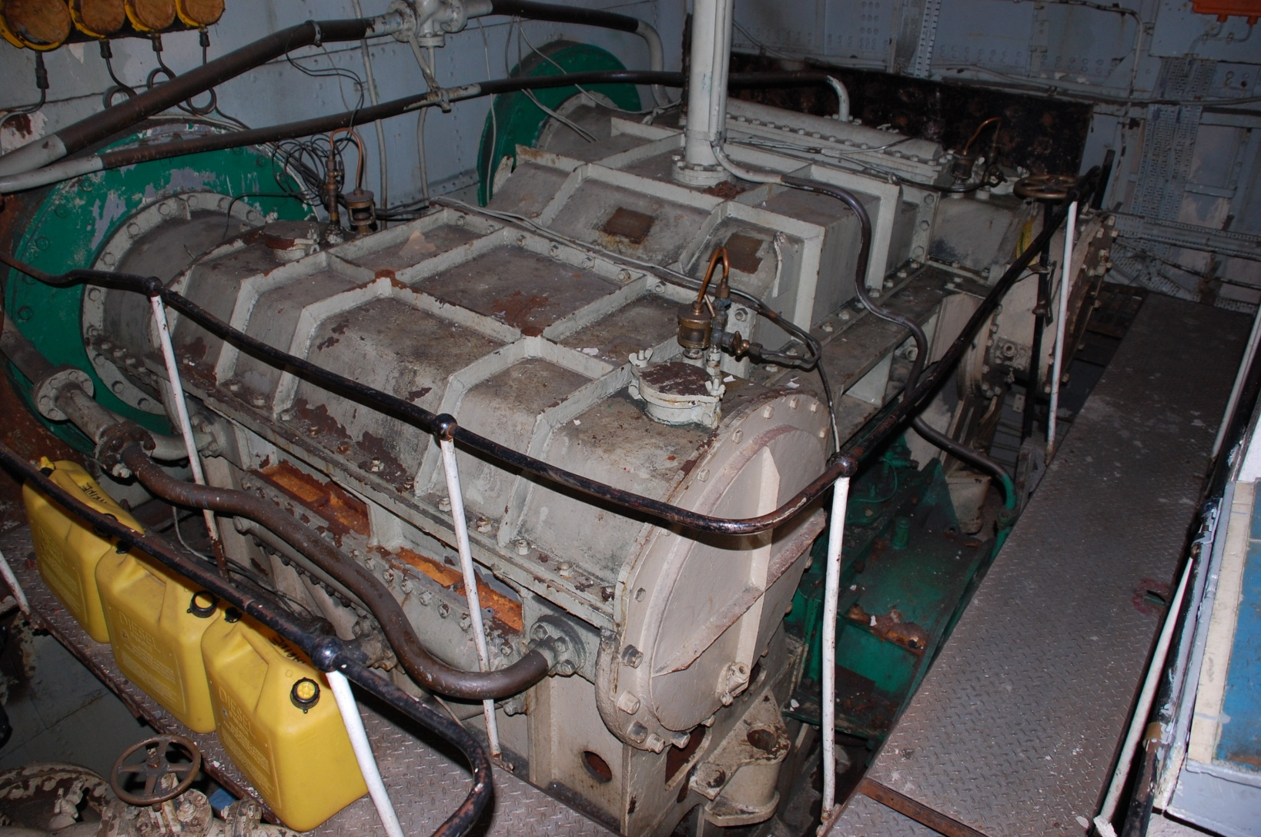
Gearbox. Reduces high RPMs from the turbine to low RPMs for the propellers.

Slide 34
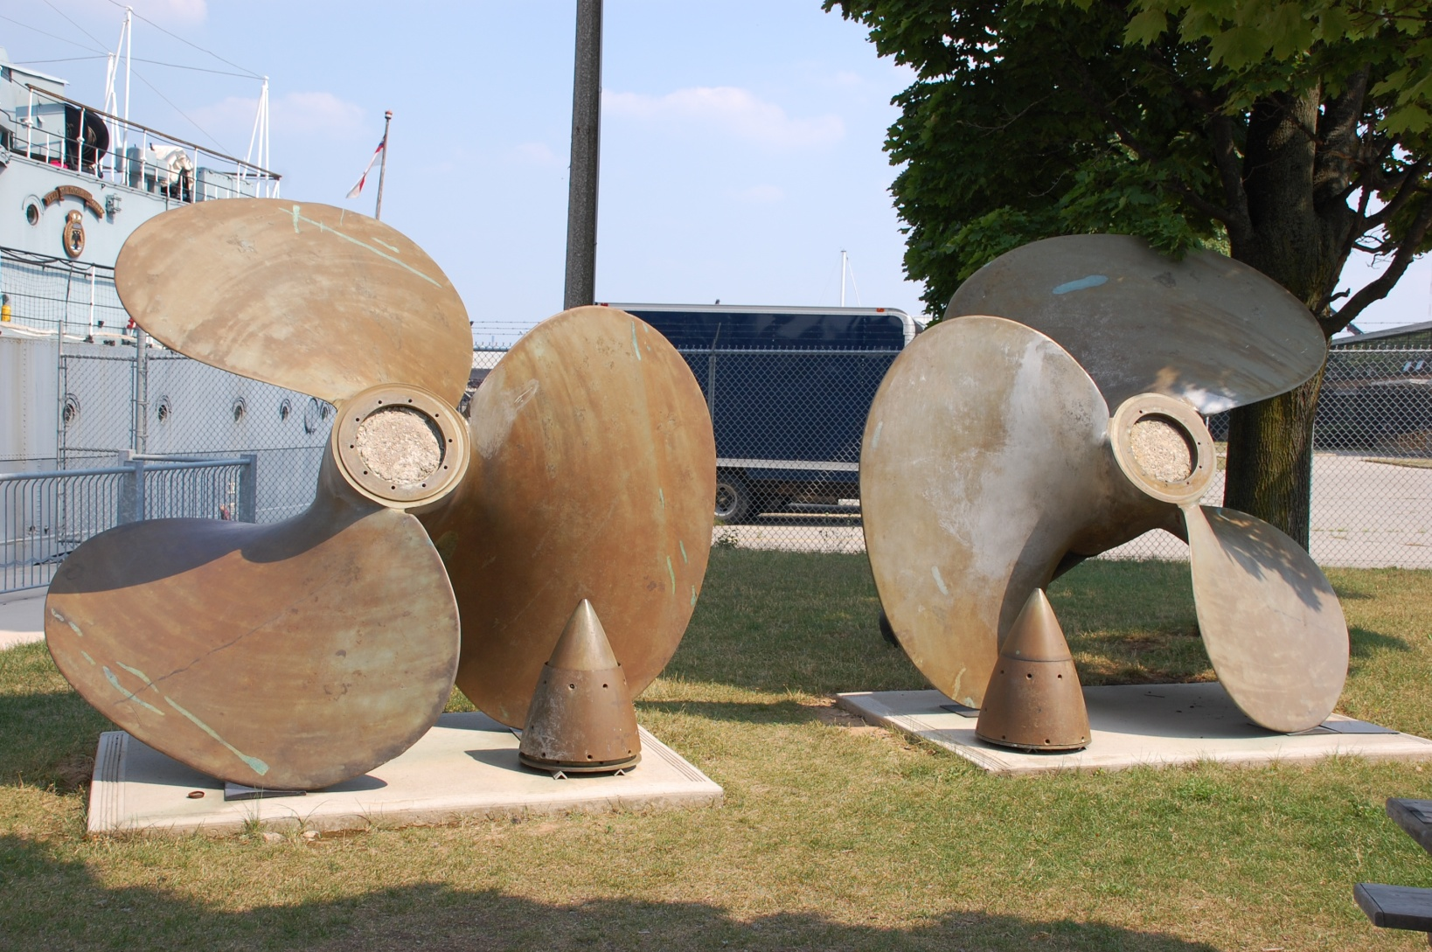
Propellers. Removed from ship to prevent electrolysis.

Slide 35
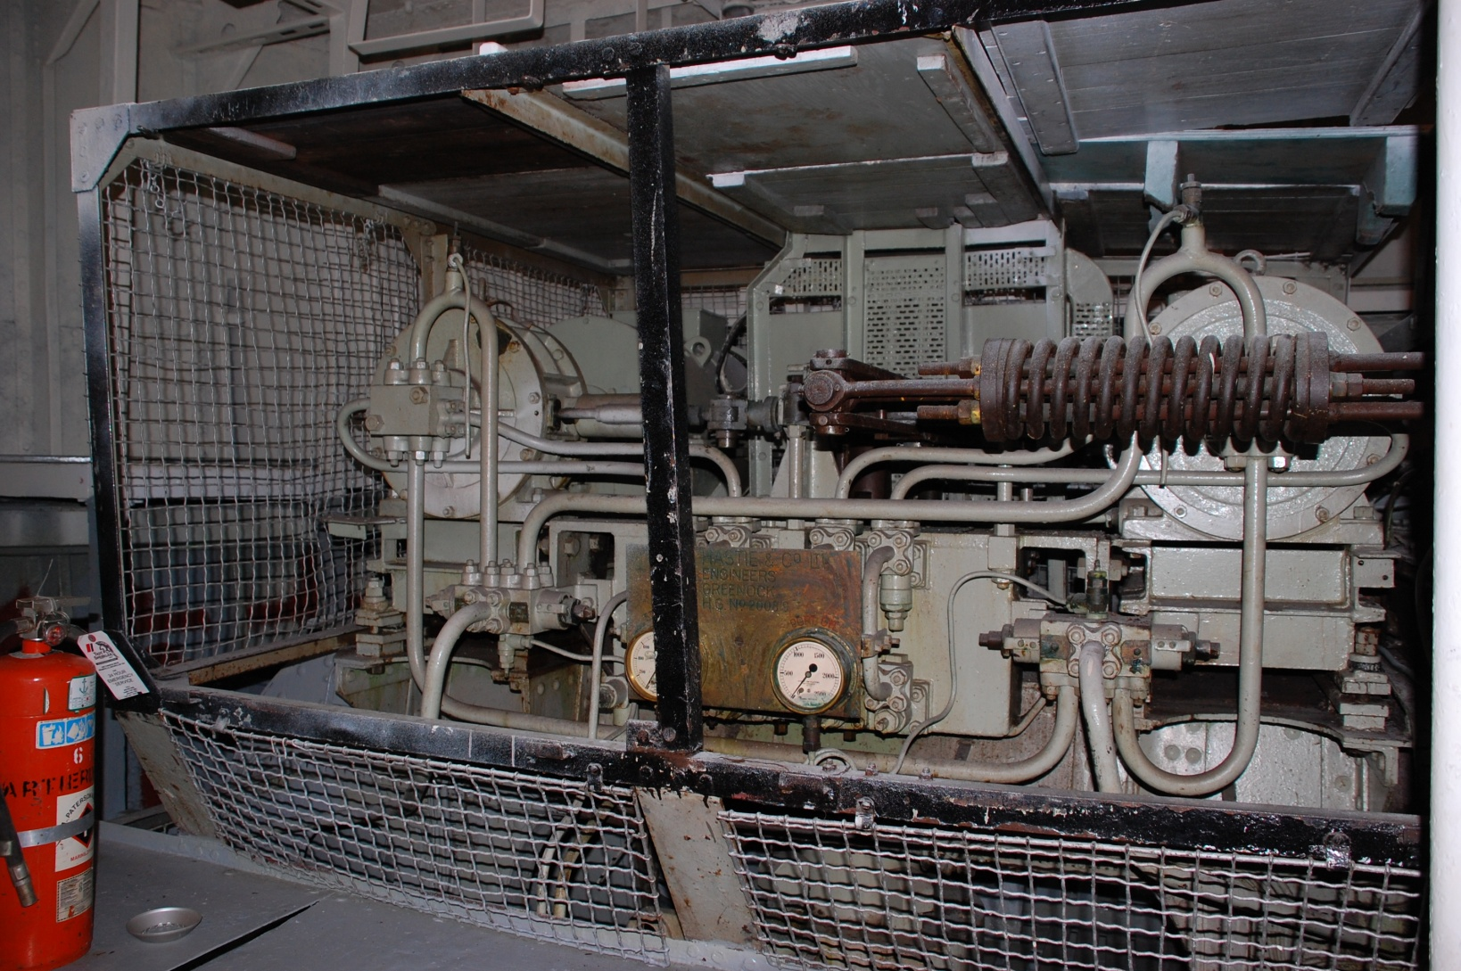
Tiller flats. The rudder’s position was controlled by electro-hydraulic steering gear based on “input” from the helmsman.

Slide 36
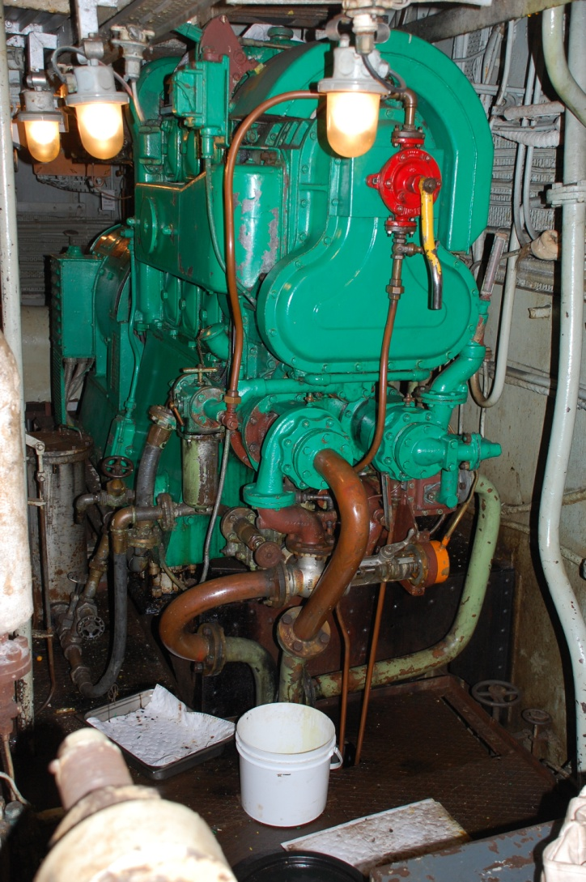
Front view of the aft 100kw motor-generator set. (1 of 2),. This one was restored to fully functional order.

Slide 37
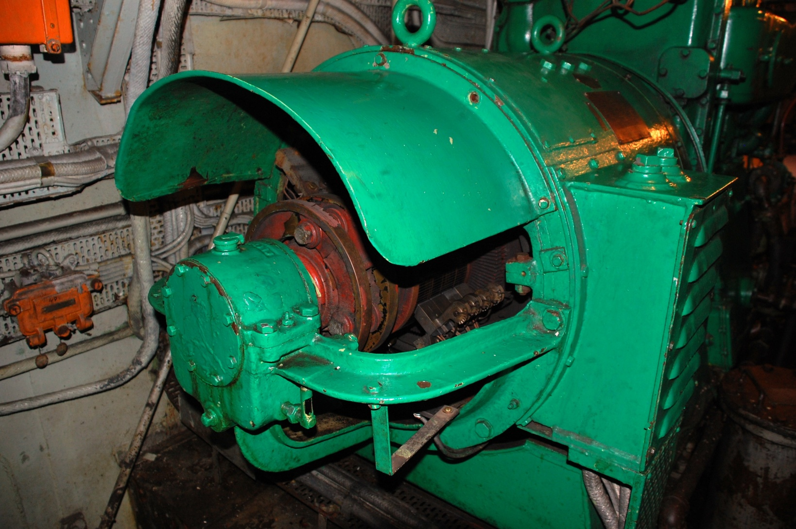
The 100KW DC generator was driven by a GM 3-268 (3 cyl) diesel engine. This “gennie” rep[aced the original 60 kw gennies that were fitted-on-build in 1943.

Slide 38
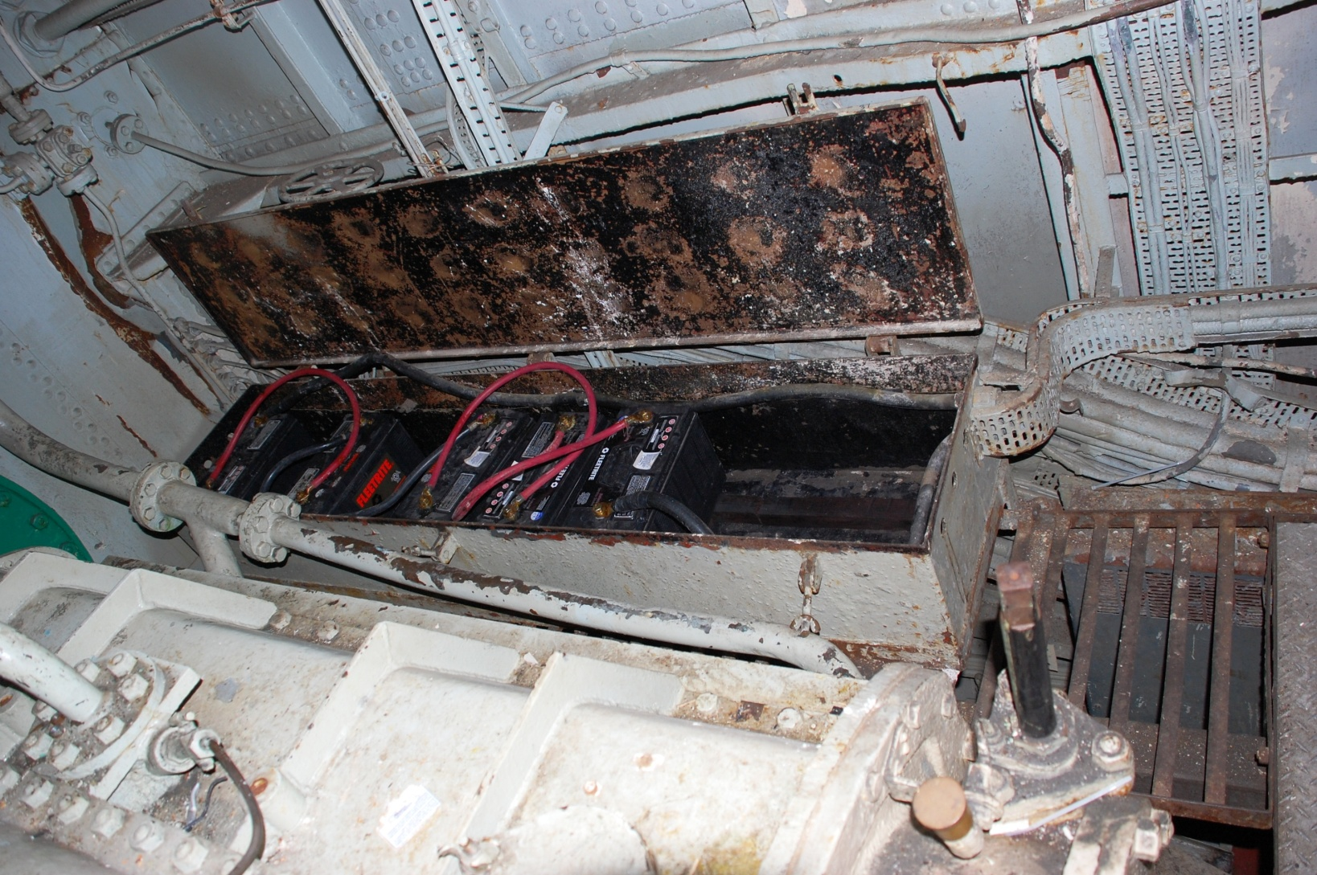
Battery used to start the generator. It originally consisted of ten 6 volt batteries wired in series to provide 60 volts . The battery had to be recharged manually.

Slide 39
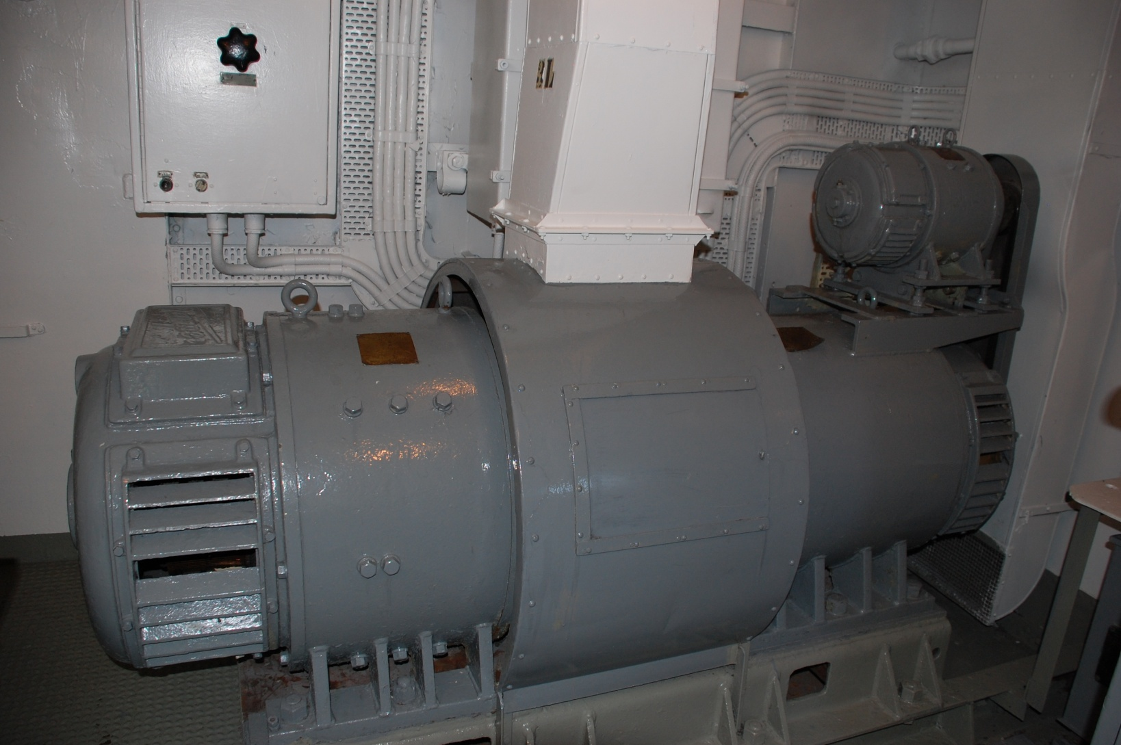
This 50 KVA motor- alternator set produced 440 volt, 3 phase (delta), 60 Hz AC power. ( 1of 2)

Slide 40
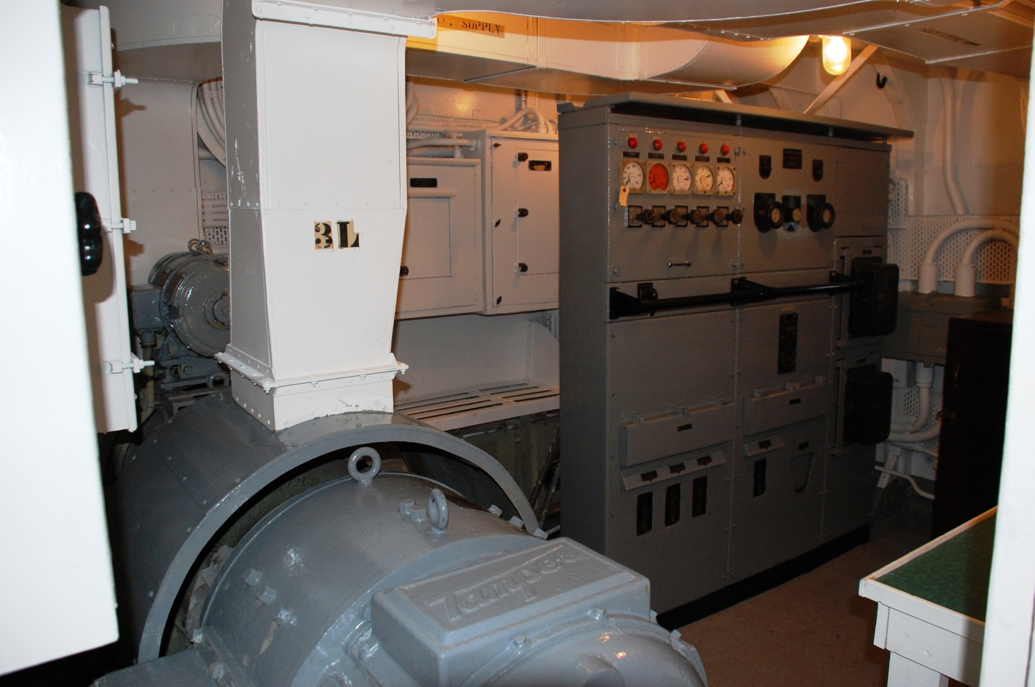
Control panel for 50 KVA M-A set.

Slide 41
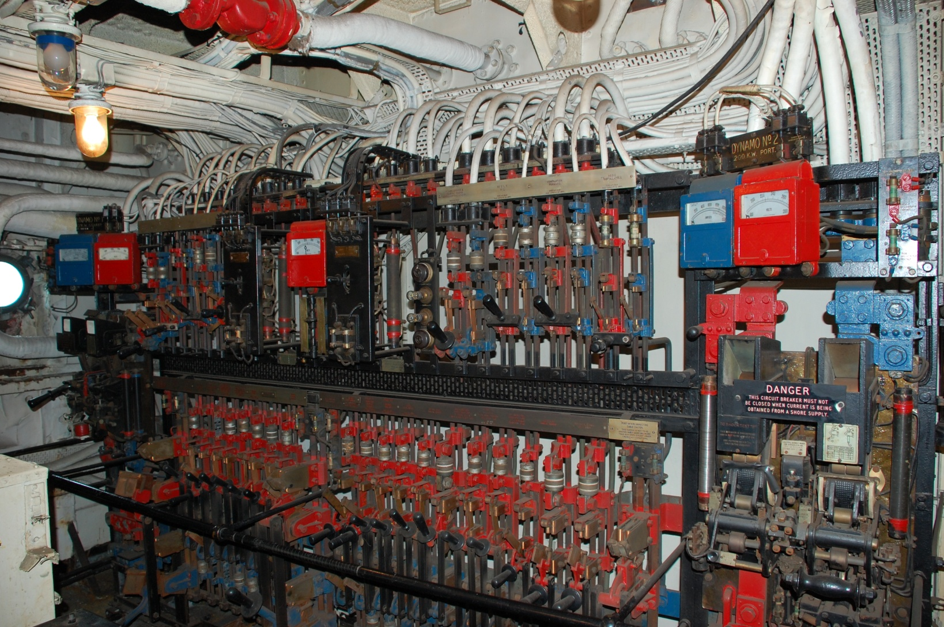
Forward electrical panel, . (1 of 2). Located in the Electrical Workshop. If one panel was put out of action, power could still be supplied from the aft most panel.

Slide 42
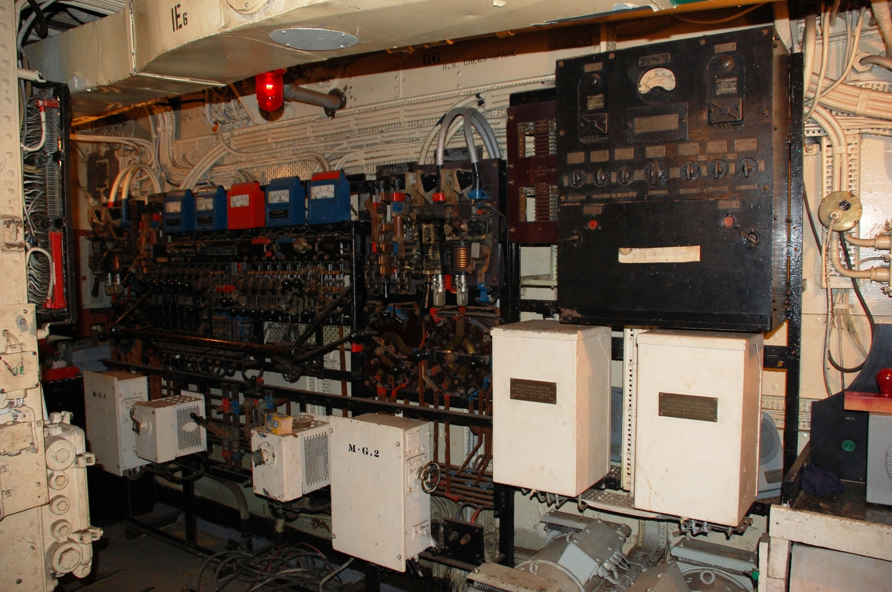
Electrical Room looking forward.

Slide 43
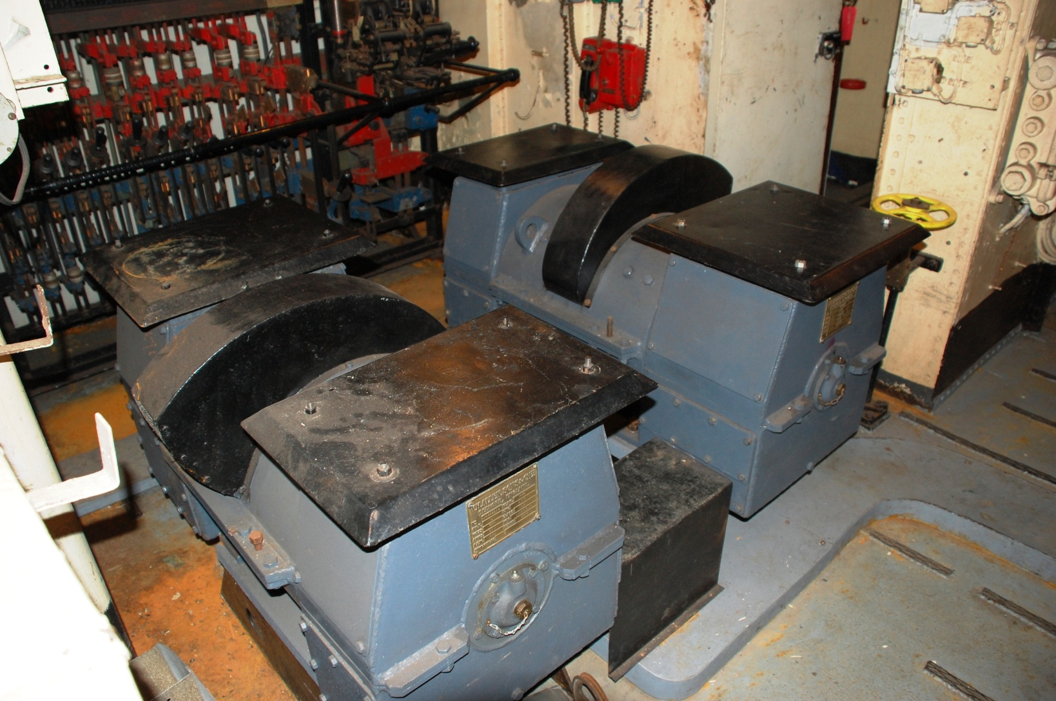
The low-power system is a 24 volt D.C. motor-generator system which is used to operate equipment such as gyro repeaters, plot tables and in an emergency, some of the radio equipment. Located in the forward Electrical Room.

Slide 44
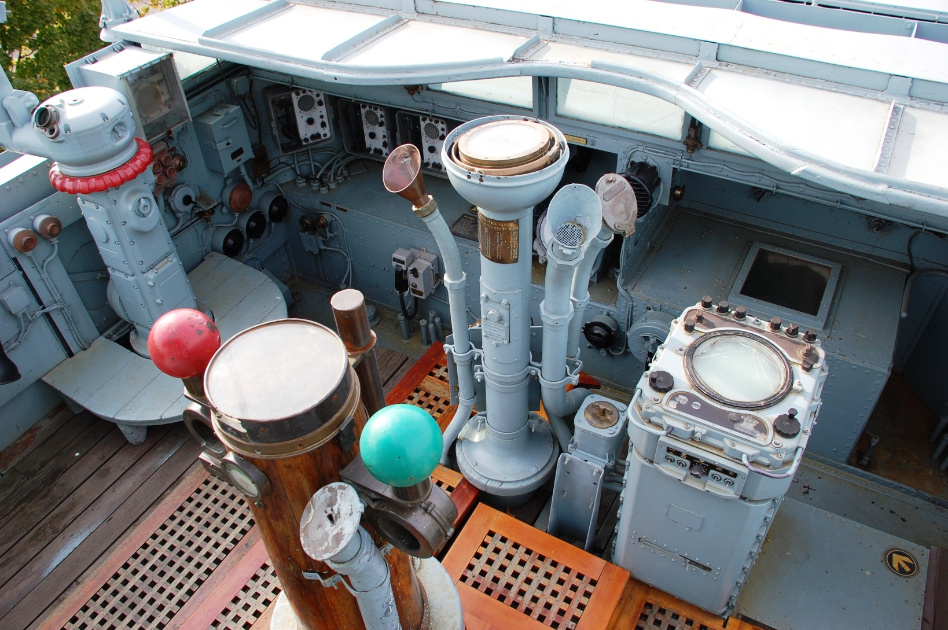
BRIDGE: View of the open bridge looking towards port. The remote radar Plan Position Indicator in the lower right could be switched to view either air or surface targets.

Slide 45
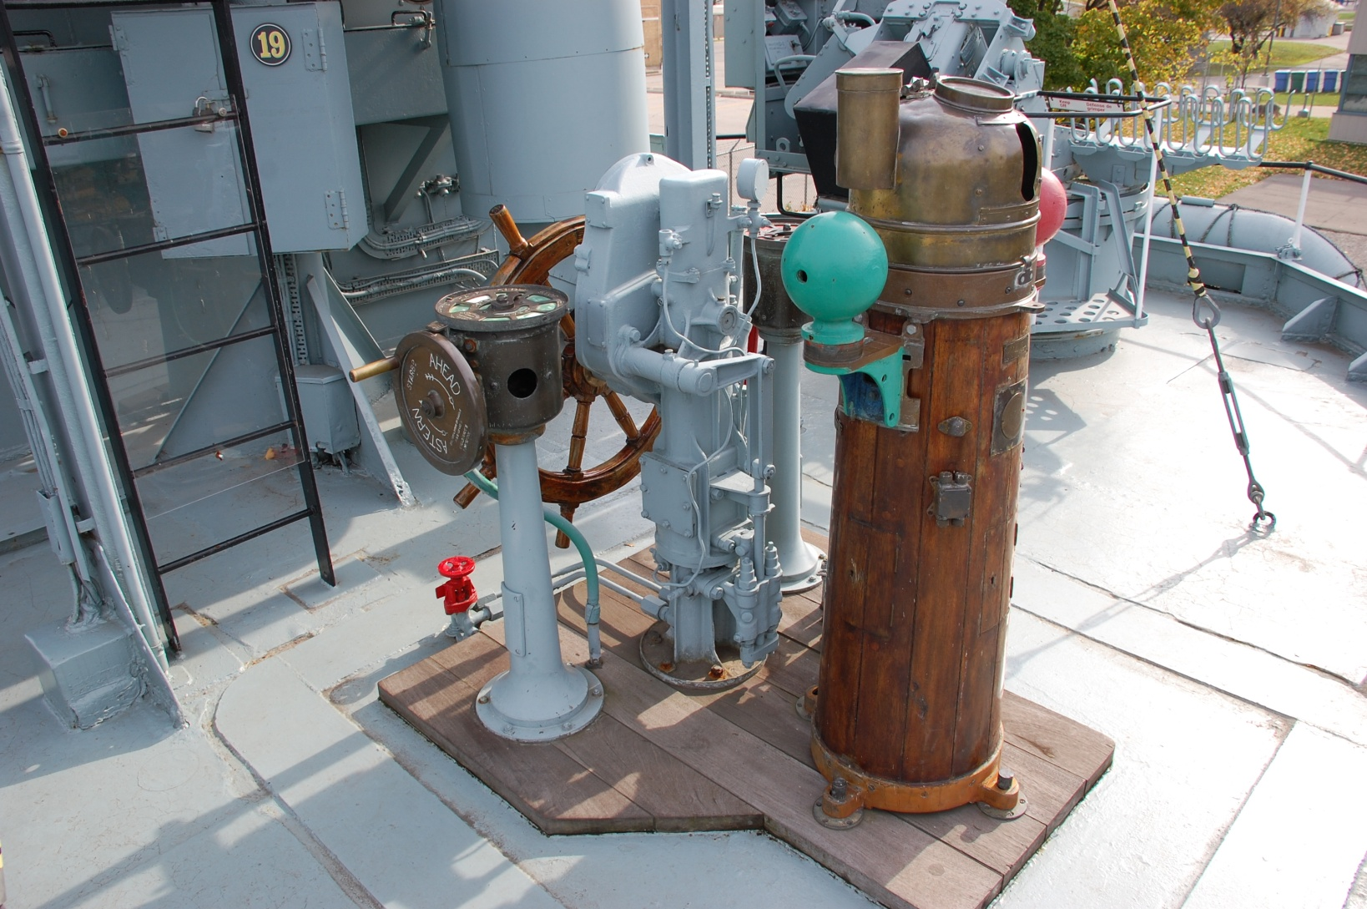
Emergency Steering Position. If the Wheelhouse was put out of action, the ship could still be conned from this position.

Slide 46
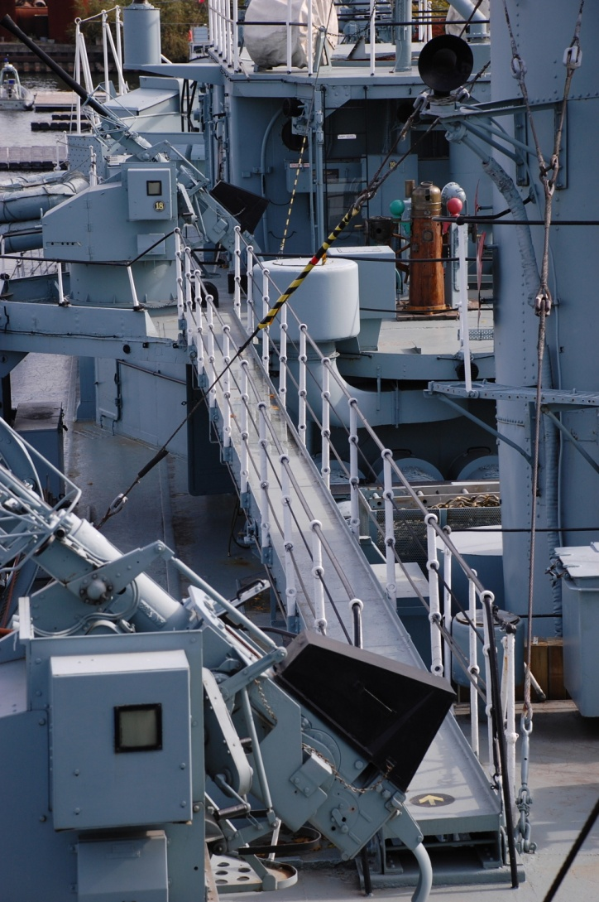
Two Catwalks were added in the October 1944 refit to make it safer to cross decks during inclement weather.

Slide 47
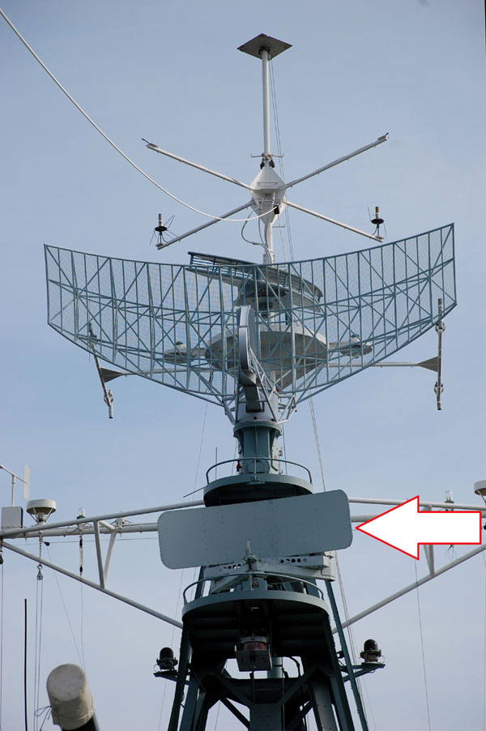
Top : A/N SPS-6C air search radar antenna . Range: 200 miles
Bottom : Sperry Mk 2 navigation antenna.

Slide 48
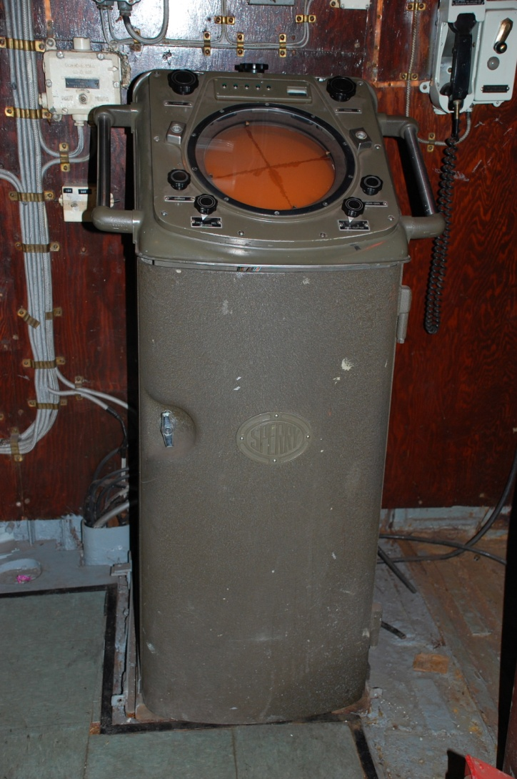
Sperry Mk 2 operator's console. This surface search radar had a range of 30 miles.

Slide 49
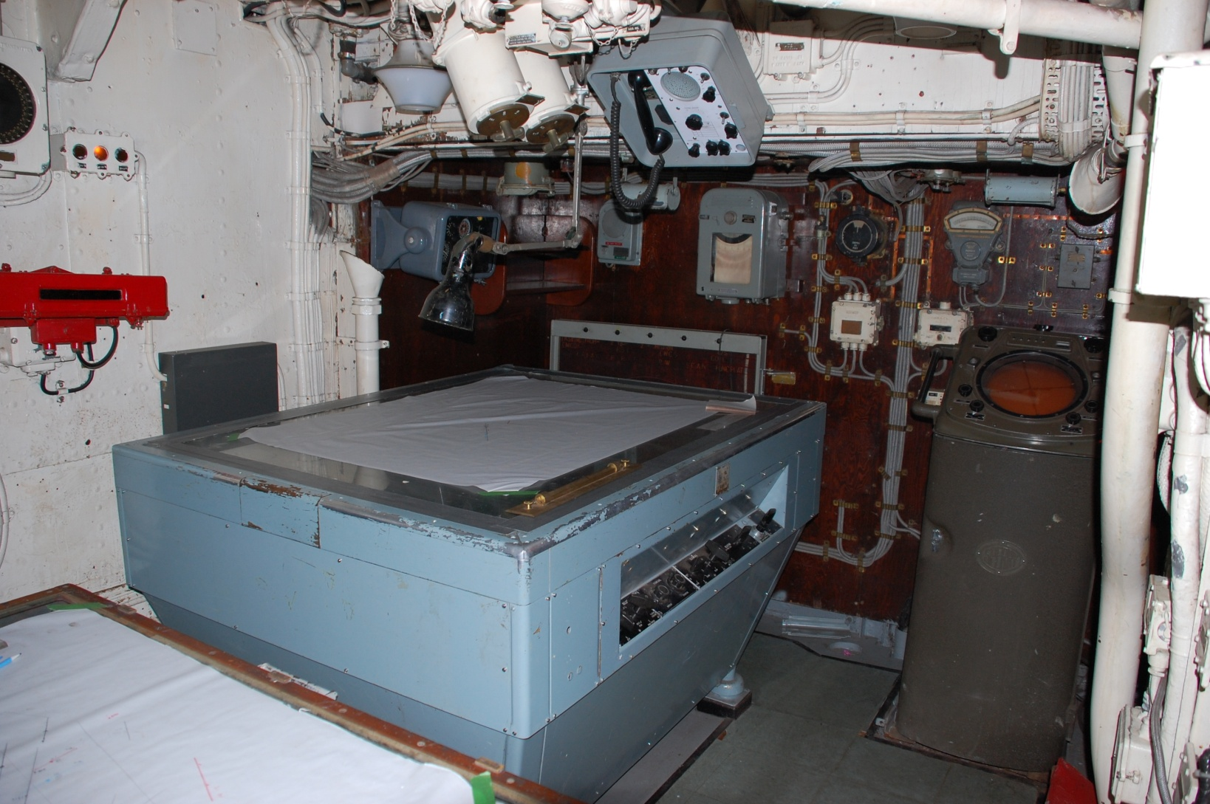
The Operations Room contained two plotting tables. One was used to record tactical (Action) movements while the other was used to record Navigational movements. The VK5 radar repeater (display) was near the forward bulkhead.

Slide 50
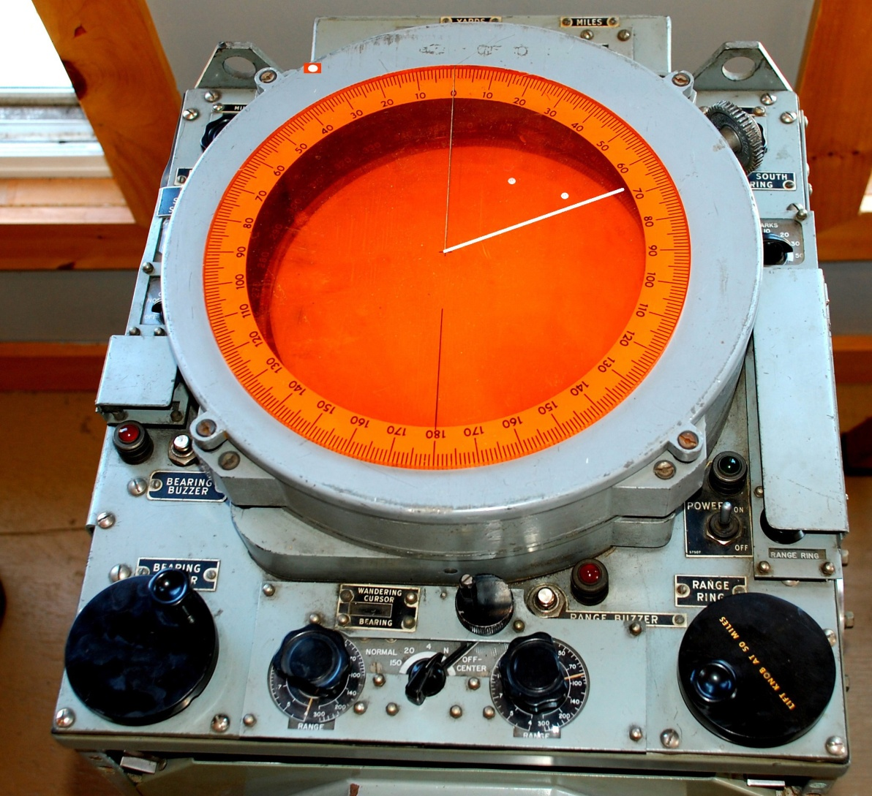
VK5 radar repeater (display). Targets at 36 and 60 degrees Green. Cursor is on 0/360 degrees. Contains 101 vacuum tubes.

Slide 51
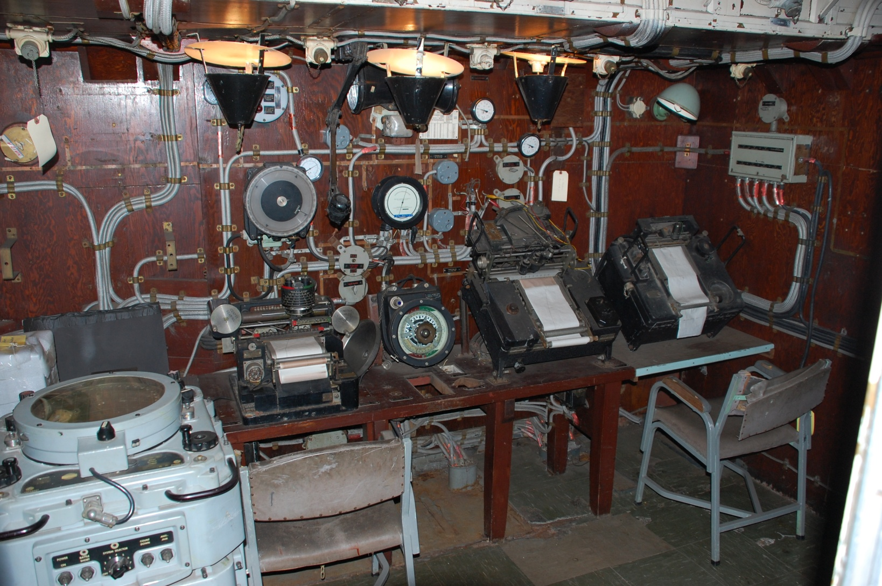
Sonar Control Room – Contained all necessary equipment to detect under sea targets and fire the Squid mortars.

Slide 52

Wheelhouse: Showing the helm and one of two engine room telegraphs. The helmsman did not look out of the scuttle. All he had to do is steer the course ordered by the Bridge.

Slide 53

Damage Control Office: Always manned when the ship was under way. Two people were stationed there to handle any emergency which might arise.

Slide 54

Captain’s Day Cabin. (Forward View) It was used by the Captain when the ship was in port or sometimes when at sea. At sea, the Captain used his Sea Cabin which was not so fancy and spacious.

Slide 55

Captain’s Day Cabin looking aft. It was equipped with an electric fireplace. In the background is his bunk and private bathroom. It was the loneliest place on the ship.

Slide 56

Bakery: Nothing is so satisfying as to bite into freshly made bread. It was made daily.

Slide 57

Canteen: Here, crewmembers could purchase sundries not supplied by the navy.

Slide 58

Main Galley: Looking forwards port.

Slide 59

Main Galley: A view towards aft.

Slide 60

Mess Deck: This was one of four Mess decks in the forward part of the ship. The black bars were used to sling sleeping hammocks. Yes…the men ate and slept in the same space.

Slide 61

Chiefs and Petty Officers mess .

Slide 62

Officer’s Galley. Meals were cooked here for the Captain and the Officers.

Slide 63

WARDROOM: view towards port. The Officers ate their meals here.

Slide 64

WARDROOM. Looking toward starboard. Here, Officers could relax or socialize during their off-watch time.

Slide 65

WARDROOM: This Officers would have had some type of entertainment radio similar to this example.

Slide 66

Officers Cabin: Except for the Executive Officer, Officers bunked two to a cabin.

Slide 67

SICK BAY: Minor ailments were treated here by the Sick Berth Attendant called the “Tiffy” or “Doc”.

Slide 68

WASH BASINS: The poster indicates the location of the showers . Water for showering had to be used sparingly.

Slide 69

Motor Cutter. Used to ferry supplies from the dock to the ship and also shuttle personnel. HAIDA had two of these and also two 27 foot whalers.

Slide 70

Radio 1. Starboard side. Main function was to copy the Morse broadcast at 25 WPM and send messages back to HQ.

Slide 71

Radio 1 – port side . UHF/VHF and Morse equipment was fitted here.

Slide 72

Message Centre adjacent to Radio 1. Radioteletype equipment was fitted in this compartment.

Slide 73

Radio 2. Port side view. It contained two Morse circuits and the radioteletype transmitter.

Slide 74

Radio2: Canadian Marconi PV500 CW/ICW/RTTY transmitter. 500 watts. 3 to 19 MHz.

Slide 75

Radio 3. It housed four out of the seven UHF voice circuits aboard the ship. It was a tight fit here.

Slide 76

Radio 4 – Electronic Warfare Office. Positions of enemy radar using Super High DF were detected here along with HF transmitters of interest which were recorded on a reel-to-reel recorder.

Slide 77


Slide 78

HAIDA in 2002. Ownership of the ship changed from the Province of Ontario to Parks Canada. Shortly thereafter, the ship was towed to Port Weller Drydock for a replacement of corroded hull plates.

Slide 79

Refit start - opening up a channel from the Ontario Place lagoon to Lake Ontario. The ship had been landlocked for 31 years without any hull maintenance.

Slide 80

Underway to Port Weller Drydock. The forward and aft tugboats are out of view.

Slide 81

Safely in drydock, the hull plate replacement can begin.

Slide 82

Zebra mussel infestation. After being scraped off, the mussels filled up a small dumpster.

Slide 83

After the mussels were scraped off, this is how the hull looked. In view is a keel block (bottom right) and a “port” for the depth finding sonar. (top center)

Slide 84

Plate replacement is underway. Only the thinnest of plates were replaced.

Slide 85

Closeup of plate removal. A total of 42 plates had to be replaced. Because the plate replacement was not symmetrical, the ship developed a 3 degree list which had to be corrected.

Slide 86

After refit. Here, HAIDA is passing through the Burlington Bay canal on August 28, 2003.

Slide 87

On August 30, 2003, HAIDA was towed to the western part of Hamilton Bay in order to start her welcoming ceremony to Hamilton.

Slide 88

HAIDA at her new home at Naval Reserve unit HMCS Star on August 30,2003.

Slide 89

Aerial view of HAIDA’s new home at HMCS Star.

Slide 90

THE END

